Slide 1
VIOLENCE INTERRUPTION
THE PMI MODEL

Slide 2
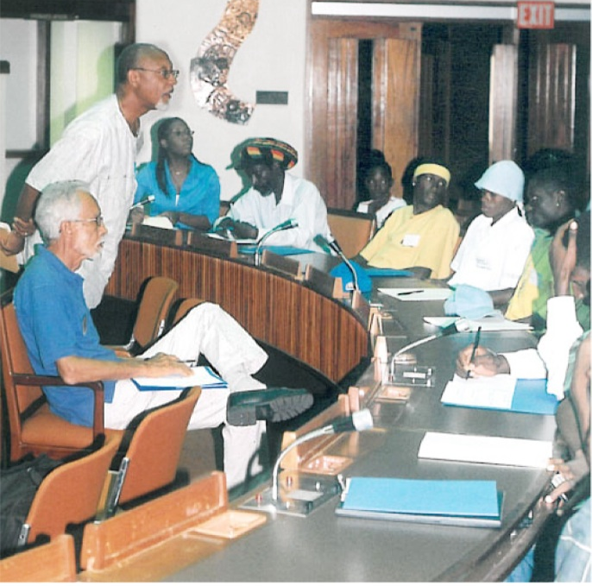
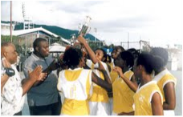
Peace Management Initiative
Mediation
Integrated Sports activities (mixed community teams)
Closed Door community meetings
Transformational workshops
Grief counseling
Income generating activities
Community Peace Councils
Facilitating a space for other social agencies to operated
Credited with stopping the wars
in August Town, Gt.Browns Town, Mountain View McLean et al 2009)
Notes:
Between 2002 2010 the PMI focused primarily on these activities.

Slide 3
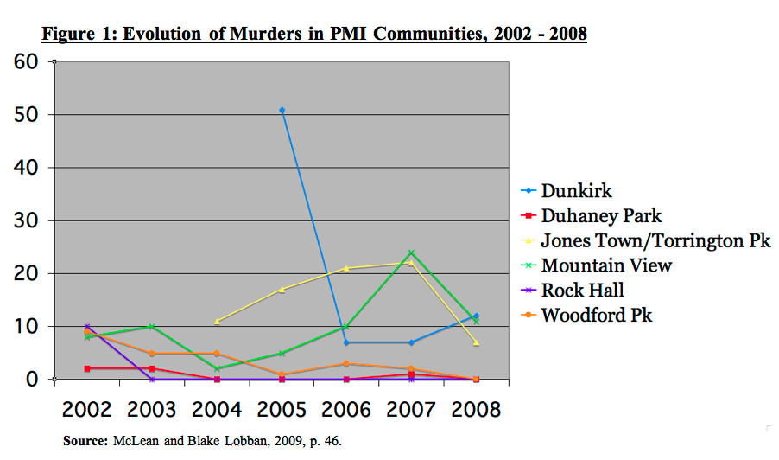
Peace Management Initiative

Slide 4
May 2010 A Watershed Period
Security Forces had the full backing of the country in going after criminals
Re- assertion of state authority saw many criminals going underground
Opportunity for Truth and Reconciliation in the society
Citizens were willing to cooperate and give information to the police - ‘A Police Time Now

Slide 5
Changing Landscape
The PMI recognized an increasing trend in the criminalization of community gangs
Gangs seeking more economic funding – refining extortion process, re-establishing gang networks
Gang Structures becoming more complicated – gun ownership and killing to increase reputation
Development of more Criminal Power Centers in Rural Jamaica

Slide 6
The Alternative Pathway
Nevertheless the PMI recognized that there was a significant set of high risk youths not wanted by the police; but who were involved in gang activity; and who still wanted an opportunity live a legitimate life
It is out of this knowledge that the PMI worked with the Ministry of National Security in developing a programme based on the work previously carried out by the PMI and elements of the CURE Violence Model
The model uses the public health approach to target where, violence was being experienced, the perpetrators carrying out the violence and the environment in which the violence was being produced

Slide 7
The Model
Community Violence Interruption (Interrupting and Detect Conflicts)
Trauma Reduction and Healing and Reconciliation Activities.
Gang Demobilization (Identifying and Treating High Risk Youth, and Youth Mainstreaming Activities).
Changing Community Norms and Values

Slide 8
Community Violence Interruption
Closed Door Mediation and Hotspot Responses:
a. Closed Door Meetings
b. Development of Peace Councils and other
sustainable community based peace keeping
mechanisms
c. Crime Scene Victim Support Responses
d. Community Walk-throughs and Fact Finding
e. Community Open Air Meetings
f. Deployment of Liaison Officers

Slide 9
Trauma Reduction/Healing and Reconciliation Activities
Community Trauma and Reprisal Reduction Programme
a. Individual and Family Venting Sessions
b. Individual and Group Counselling Sessions
c. Therapeutic Field Trips and Psychological
Assessments
d. Trauma adjustment stakeholder meetings and
sessions
e. Case File Development and Referrals

Slide 10
Gang Demobilization and High Risk Youth Mainstreaming Activities
Profile and identify highest risk youth
Establish pathway programme for high risk youth to connect to mainstream activities
Implement residential workshops to facilitate data collection on highest risk youth and initiate case management process.
Provide life skills training and anti-gang workshops for highest risk youth.
Link highest risk youth into mainstream activities
Developing Community Safety Groups to facilitate continued engagement and monitoring of high risk youth.

Slide 11
Profile of the High Risk Youth
Age 16 -27 years
School Drop Outs
Unemployed / Unemployable
Mentally Unstable (High Trauma Level)
Been incarcerated
Involved in Gang Activity
Have easy access to guns
Been involved in shootings before
Been shot or have had family member shot
Have friends involved in gang activity
Involved in robbery/extortion/scamming
Previously involved in killings

Slide 12
March Pen Experience
50 High Risk Youths Interviewed
Aged 15 – 27 years old
60 % of them incarcerated at least once
78% of them dropped out of school
60 % grew up in a single parent household
80 % of them dropped out of school because of a lack of money
80 % had a family member killed
70 % involved in gang activity

Slide 13
Changing Norms and Values
Strengthen the capacity of communities to participate in creating a safe space
Empower communities to become independent of the criminal gang networks and participate in mainstream society.
Community Integration activities – (Sports and Cultural activities)
Community Safety Youth Groups
Women’s Empowerment Groups
School Based Intervention
Capacity Building support for Community Based Organisations (CBOs)

Slide 14
Effectiveness of Programme to Date
The Ministry of National Security support VI Programme started June 2014
The effectiveness of the programme is currently being evaluated
The programme targets 10 areas in St. Catherine, 5 in Kingston and 5 in Clarendon (20 target areas overall)
Treated and referred at least 500 potential violence producers treated and or referred
At least 2500 high risk youth engaged weekly by the Violence Interrupters across these 20 target areas.
At least 12 of the 20 target areas have recorded less than 3 murders over the past 10 months
At least 8 of the 20 target areas have recorded no murder in their spaces over the 6 months.

Slide 15
Critical External Factors
SAFE and SUSTAINABLE Communities
Communities in CRISIS
3. Data Driven and Coordinated Sustained Approach
2. Good Community Policing
1. Supportive Political Environment

Slide 16
Community Transformation Model
Community Transformation
SAFE,JUST & SUSTAINABLE
CRISIS
Ceasefire/ Safe Community
Community Building Activities
Community Development
Community Sufficiency
Healing and Reconciliation
community sports and arts
small income earning projects
Literacy
Green spaces
Sustainable Economic Activity
literacy/Computer lit
Infrastructure projects
skills training
job placement
micro-enterprises
Interrupting Community Violence
engagement and mediation
therapeutic camps, counselling
peace treaties
Community Governance Structures
peace councils
community engagement in development planning
SDC,PMI,,CSJP CSI, JSIF, JCDC Churches, NGOs, CBOs GOVT
PMI, Churches, Police, NGOs, CBOs, trained counsellors
PMI,Churches,CSJP,JSIF NGOs, CBOs, Private Sector,GOVT
JBDC, CSJP, CBOs, NGOs VPA, Private Sector, HEART NTA,GOVT

