Slide 1
Best Practice Symposium
Trench Town:
A Case Study in the SDC Community Organizational Model
Presenter: Trevor O. Spence
Notes:
Thanks for the opportunity to share this very important community development process

Slide 2
Summary: Presentation on Best Practices
National Context: Policies, Agencies, Projects, Local Governance
SDC Mandate and Approach
Trench Town: Model, Challenges, Community Assets, Legal Body, Planning
Summary of Elements of Best Practices
Notes:
The review will look at the national context; the mandate of SDC; and the Trench Town Model that was developed using the SDC Community Organizational Model.
The presentation will conclude with key elements that can be pulled out as best practices.

Slide 3
National Context: Policies to support Community Development (50+)
National Cultural Policy
National Youth Policy
National Sports Policy
National Policy on Children
National Policy Statement on Women
National Policy for Senior Citizens (1997)
National Policy For Persons With Disabilities (2000)
Reform of Social Safety Net (Ministry Paper #5, 2002)
Tourism Master Plan for Sustainable Development
Local Government Policy (2003)
Strengthening of SME Sector
Development of an Entrepreneurship Culture
Education: The Way Upward
Notes:
There are multi-polices – central government policies that determine interventions at the community level

Slide 4
National Context: Agencies to support Community Development
SDC
PIOJ
NEPA – LWMC
Forestry Department - LFMC
Jamaica Cultural Development Commission
National Youth Council
Institute of Sports
Sports Development Foundation
CDA
Tourism Enhancement Fund
Ministry of Local Government
Local Authorities
Ministry of Education
Notes:
Similarly, there are multi-agencies involved in community interventions.

Slide 5
National Context: Projects
Integrated Community Development
Local Government Reform Framework
Community Renewal Programme – PIOJ
Citizens Security and Justice Project (CSJP)
Jamaica Social Investment Fund (JSIF)
Notes:
As well as multi-projects

Slide 6
National Context: Local Governance
Project-driven (random-selected demonstrations or pilots vs. Integrated Planning. Micro-level without upscaling lessons learned
Short-term – project has defined starting time and end time. Lack continuity; often leading to feelings of frustrations and hopelessness
Agency-focus – silo planning, lacks coordination.
Decision-making process – not inclusive
Notes:
The community interventions are project-driven; short-term; agency-focus; silo-planning; fragmented; lack coordination and is not-inclusive of all stakeholders. Un-like cricket

Slide 7
SDC’s Mandate and Approach
Improved skills, attitudes, problem solving and management capabilities
Increased participation in community driven initiatives
Increase and improve organized and representative local structures
Increased confidence to influence decisions which affect people
Notes:
SDC – the agency with the mandate for community development, although resources are shared with all the other agencies. No real discussion regarding what supersedes

Slide 8
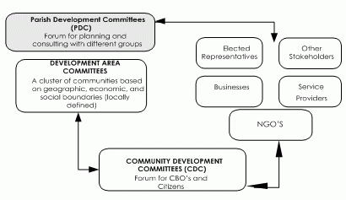
SDC’s Mandate and Approach
Integrated Community Development and Local Government Reform Framework
Notes:
Lets review the SDC model – building block approach
Clusters of CBOs in a geographical area = District Development Committee (DDC)
Cluster of DDCs = Community Development Committee (CDC) = Trench Town CDC
Cluster of CDCs = Development Area Committee – part of the Downtown Kingston Development Area
Cluster of Development Areas = PDC (KSAPDC)
Cluster of PDCs = NAPDC (National Association of PDCs)

Slide 9
Trench Town Community
Notes:
A great deal of effort has been given to the SDC Model by the Trench Town CDC – focus on capacity development of CBOs and development the District Development Committees (DDCs). There are 4 or 5 Districts (Wilton Gardens (Rema); Federal Gardens (Heritage Village); Rose Town; Lyndhurst/Greenwich; and Arnett Gardens

Slide 10
Trench Town Approach: Development Model
Trench Town Development Model
Trench Town Development Trust
Trench Town Development Company
Trench Town Community Development Committee (CDC)
Notes:
The Trench Town CDC has developed its own model within that context – three-legged stool:
CDC has the wide governance mandate. It is expected that the properties of Trench Town (government-owned) could be turned over to a Trust that will ensure the interest of the residents of Trench Town. A Development Company made up of committed skills will bring the technical expertise for the harmonious development of Trench Town

Slide 11
Community Development Model: Champion Model
Core Themes
Collective responsibility
A value system
Methods
Partnering for Education and Training
Resources
Local Capital: Natural and Heritage
Notes:
Boys’ Town, the oldest community development model in inner-city Kingston recognises the need to champion this process. The Boys’ Town Model, articulated in the last decade, but originating in the first years of the development of Boys’ Town (1940); informs and mentor the Trench Town CDC

Slide 12
Trench Town Approach: Challenges
Multi- Agencies
What supersedes
Political Tribalism
Disconnection: internal & external, local & national
Project-Driven
Silo-Driven
Strong Individual Interest
Notes:
The model faces several challenges – political divides; how to deal with disconnect from citizens and how to overcome the self-interest of several stakeholders at both community and organizational levels

Slide 13
Community Assets
Human Resources
Organizations
Culture: Heritage Village, Reggae, Rastafarian, Garvey, Ambassador Theatre
Sports
Youth Development
Education
Training
Entrepreneurship
Notes:
Value Community Assets

Slide 14
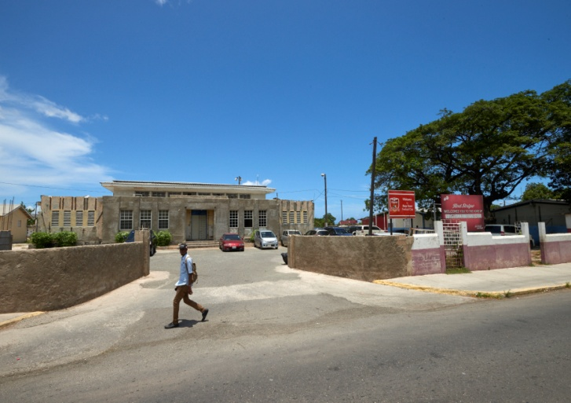
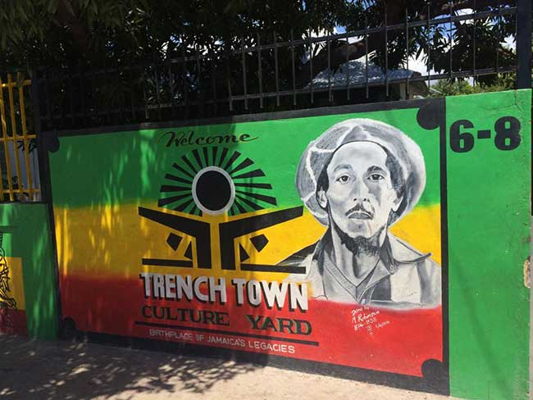
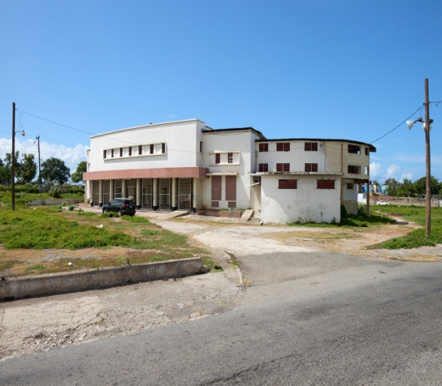
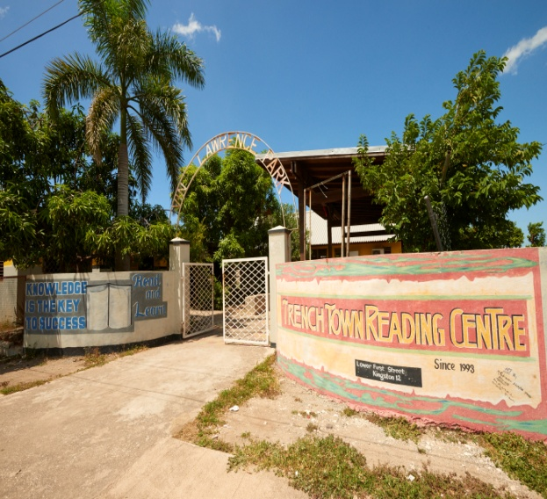
Community Assets
Notes:
Boys’ Town; Boys’ Town VTC; Trench Town Culture Yard; Trench Town Heritage Village’ Ambassador Theatre; Trench Town Reading Centre

Slide 15
Trench Town Approach: Legal Body
The Department of Co-operatives and Friendly Societies (DCFS) executes regulatory and supervisory responsibilities through the administration and enforcement of the Co-operative Societies Act (1950), the Friendly Societies Act (1966) and the Charities Act (2013), along with their respective regulations. The Department monitors and supervises charities, credit unions, benevolent societies, authorized and friendly societies, agricultural societies and fourteen other types of producer and service societies.
Notes:
To be a legitimate actor, the CDC must be registered to do business

Slide 16
Strategic Planning – Organization Development
Vision: To be the model for transformation within community both local and oversees
Mission: To be a model CDC of Excellence serving the community through providing opportunities for educational, social, cultural, recreational, economic and spiritual empowerment towards transformation
Motto: (4B’S) Breaking Barriers Building Bridges
Notes:
Involve in Organization Development and Strategic Planning

Slide 17
Trench Town Approach: General Objectives
To build capacity and empower members for active participation in community development.
To act as an umbrella group for CBOs within the districts of Trench Town for information sharing, transparency, transformation and sustainability of the development process of the community
Notes:
Develop Programme and Operational Processes

Slide 18
Components of CDC Organization
Documentation of Policies, Procedures, Programmes and Projects
Development of COM and Audit Committee
Development of Membership Process
Reporting
Communication
Meetings
Election Policies
Book-keeping/Financial Recording
Fixed Assets Register
Notes:
Develop Operational Processes

Slide 19
Trench Town Approach: Programme Objectives
Promote and sustain community heritage and cultural development as a part of peace building
Promote and implement sporting activities as a developmental tool for youth transformation
Empower and build capacity among residents to participate actively in community governance
Improve community environment, infrastructure and living conditions
Notes:
Prioritize Programmes and build projects and activities around those

Slide 20
Elements of the Trench Town Model: Summary of Best Practices
Consensus – Building
Process-driven (not individual)
Inclusive – all Districts
Ownership
Accountable and Mandate
Partnership
Programme Driven (not projects)
Capacity-Building – succession planning
Utilization of Local Assets
Identify Champion
Notes:
Summary

