Slide 1
The Coordinating Role of the SDC, Clarendon Inter Agency Network
Presented by: Mr. Baldvin McKenzie BSc., CD, JP
Parish Manager - Clarendon

Slide 2
PARISH INTER-AGENCY NETWORKING PROGRAMME (PIAN)

Slide 3
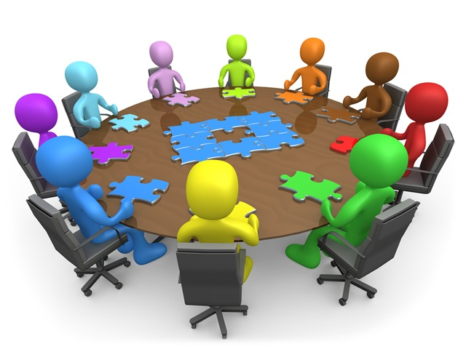
AREAS TO COVER
PIAN PROGRAMME
DEFINITION
CORE FUNCTIONS
PARISH STRUCTURE
MAIN FOCUS
COVID-19 INTERVENTION
SUMMARY
END

Slide 4
PARISH INTER – AGENCY NETWORKING PROGRAMME
WHAT IS AN
INTER-AGENCY NETWORK?
A mechanism at the Parish level that supports effective collaboration of service providers for efficient and targeted quality service delivery.

Slide 5
PIAN CORE FUNCTIONS
Maintain capacity building for 13 IANs.
Promote strong & permanent linkages with Local Authorities
Organize & Coordinate Joint Interventions across all parishes
Implement a Robust Monitoring & Evaluation Framework

Slide 6
PIAN SUMMARY STRATEGIC POSITION
PROGRAMME: OBJECTIVE(S) | Parish Inter-Agency Networking (PIANP) To improve the quality of service delivery to residents through effective and efficient collaboration among service providers.
National Goal #1: Jamaicans are Empowered to Achieve their Fullest Potential | Sector Outcomes: Social Protection Increased access and benefit to the Social Safety Net Programs by vulnerable citizens Enhance community safety and security Improved relations between citizens and police Increased participation of citizens in anti-crime initiatives Increased participation of police in Parish/community level meetings (CSOs and Inter-Agency Network) Gender mainstreaming
National Outcome #3: Effective Social Protection | Contributing GOJ Strategic Priority: Social protection

Slide 7
CLARENDON INTER AGENCY NETWORK
Governance Structure: Mayor Co- Chair & SDC Parish Manager the other Co- Chair
Administration: Mayor’s Secretary along with the SDC Parish Administrator carrying out the secretarial duties
Sub Committee Establishment: dependent on the focus and activities of the group

Slide 8
MAIN FOCUS
Coordination is one of the major pillar of the Inter Agency as it creates an avenue for MDA and other Social Services groups within the parish to work together in coordinated and collaborative ways.

Slide 9
How this is done?
Through our monthly meetings. Issues and activities are shared and plans put in place for intervention in communities with an entity identified and agreed to coordinate the intervention process to maximize the outcomes and impact.

Slide 10
WHY?
This approach is critical to the delivery of service to the public/clients within the parish as it prevents overlapping, resource mobilization and utilization for maximum benefits to the clients or targeted group and easy access to services. With the COVID-19 Pandemic this approach was needed even now more than ever.

Slide 11
COVID-19 INTERVENTION
COVID-19 Parish Intervention was one of the many interventions that demonstrated the benefits of coordination.
Multi-sectoral approach used by Gov. Agencies, Civil Society Organizations, the Chamber of Commerce, elected representatives and ordinary citizens with diversified strategies and approaches.

Slide 12
COVID-19 INTERVENTION
COVID-19 Parish Intervention was one of the many interventions that demonstrated the benefits of coordination.
Multi-sectoral approach used by Gov. Agencies, Civil Society Organizations, the Chamber of Commerce, elected representatives and ordinary citizens with diversified strategies and approaches.

Slide 13
COVID-19 INTERVENTION
This required a coordinated approach to be taken and this is how the Inter Agency provided this platform for coordination to take place.
In this case the Clarendon Health Department was the lead agency and such they coordinated all the activities and gave an update at the Inter Agency Meeting.

Slide 14
COVID -19 ACTIVITIES
Town Cry Services
Physical Intervention in the targeted communities
Small group meeting with key stakeholders from the communities & elected representatives
WhatsApp group developed and used to disseminate information
Utilization of virtual platforms to reach persons where ever they are in spite of the lockdowns and curfews
Through this network, each member help with dissemination of COVID-19 information

Slide 15
SUMMARY
Coordination allows for maximized resources , easier access to social services, increased benefits, shared scare resources, effective and efficient implementation of programmes & activities that positively change the lives of people in the parish
Commendation to the Clarendon Team. Coordination and calibration are at the forefront of the parish as we contribute to the achievement of Vision 2030 Jamaica.

Slide 16
THE END

Slide 17
QUESTION
How often does the Clarendon Inter Agency Network meets

Slide 18
ANSWER
Weekly
Monthly
Bi Monthly
Quarterly
Answer: Monthly

