Slide 1
STRENGTHENING DEVELOPMENT through the use of
GEOSPATIAL TECHNOLOGIES
BEST PRACTICES SYMPOSIUM 2018
Planning Institute of Jamaica – Ms. Patrine Cole
Jamaica Social Investment Fund – Ms. Tami Palmer, Mr. Stephan Sinclair

Slide 2
Contents
Background of Geospatial Technologies in the GOJ
Uses of GIS in Government Entities
Case Study: Barrett Town - Integrated Community Development Project

Slide 3
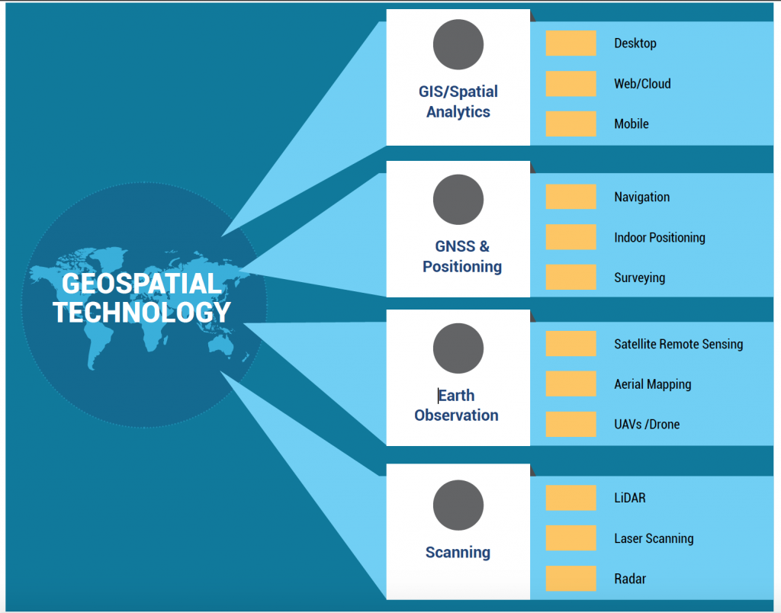
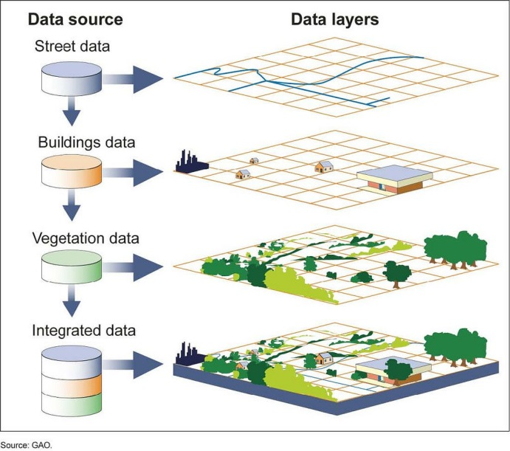
What are Geospatial Technologies?
Geospatial technologies are a collection of various tools and techniques that assist in the spatial mapping and analysis of the Earth and human societies.

Slide 4
Geospatial Technologies in the GOJ
Land Information Council of Jamaica (LICJ) was established in 1992 to implement the National Land Information Policy and Strategy and a national geographic information system network.
Development of Best Practices and Guidelines
Metadata Guidelines
GIS Best Practices
Since the signing of the Enterprise License Agreement between the GOJ and ESRI in 2015 some 4,612 ArcGIS licenses have been disseminated to 53 MDAs by the National Spatial Data Management Division (ESSJ, 2017).
Notes:
ESRI – Environmental Systems Research Institute is the foremost supplier of GIS software, web GIS and geodatabase management applications.
Licenses deployed include: ArcMap, ArcGIS Pro, Collector for ArcGIS and Extensions such as Spatial Analyst, Geostatistical Analyst, CityEngine, 3D Analyst
National Spatial Data Management Division – a division of the Ministry of Economic Growth and Job Creation responsible for coordinating the development, implementation, maintenance and management of a national spatial data infrastructure for Jamaica and to promote the sharing and use of geospatial data

Slide 5
Uses of Geospatial Technologies
There are various areas in which geospatial technologies are utilized across the GOJ, such as:
Natural Resource Management
The Forestry Department, The Water Resources Authority and Sugar Industry Research Institute
Development Planning
Municipal Corporations and NEPA
Community Development
SDC – asset mapping (businesses, social amenities)
PIOJ – monitoring and evaluation
Notes:
The Forestry Department uses GIS and GPS to, among other things, accurately capture boundary delineations to assist with the monitoring of encroachment and illegal forest activities.
The Water Resources Authority uses GIS to manage a groundwater level and abstraction database that enables the development of groundwater flow lines and assists with assessing the impact of groundwater abstraction. WRA also maintains an online web map that shows streamflow and groundwater level information.
The Sugar Industry Research Institute used GPS tracking to conduct time and motion assessment of tractors and other equipment from loading to factory delivery to improve harvesting logistics
The Municipal Corporations and NEPA have used GIS and GPS to conduct land use surveys which help to inform the development of local sustainable development plans and the preparation of development orders
Social Development Commission – uses GIS and GPS to map community assets including the presence of businesses, social amenities (such as hospitals, health centres, fire stations), infrastructure (street lights and fire hydrants) etc. Asset mapping provides information that can be used to address the social, physical and environmental needs of the community.
PIOJ – has utilised GIS to assist with the monitoring and evaluation of the Community Renewal Programme, by creating apps from which the Programme Unit can easily access information on the communities in which they work.

Slide 6
Initiatives and Special Projects
Disaster Mitigation and Management
National Emergency Response GIS Team (NERGIST)
– initial damage assessment
ODPEM – multi-hazard risk assessment
Crime Mapping
Ministry of National Security - Jamaica Crime Observatory (hot spot maps)
Weather Forecasting
MSJ/Met Office – map rainfall frequency & prediction
Notes:
NERGIST – National Emergency Response GIS Team comprises approximately 45 trained professionals who are deployed post disaster to conduct an initial damage assessment – including the mapping of damaged buildings and critical infrastructure. The assessment supports ODPEM’s post disaster response planning.
ODPEM – has utilised geospatial technologies to conduct multi-hazard risk assessments in several communities, with an aim of understanding risks and improving decision making and disaster risk reduction.
MNS – The Ministry of National Security maintains the Jamaica Crime Observatory which includes mapped locations of reported criminal offences (murder, sexual assault, robbery etc.). The observatory can be used to create heat maps of the concentration of criminal activities, which informs resource allocation and systematic interventions.
Meteorological Service Jamaica – uses GIS to map rainfall frequency, and to predict weather from known values

Slide 7
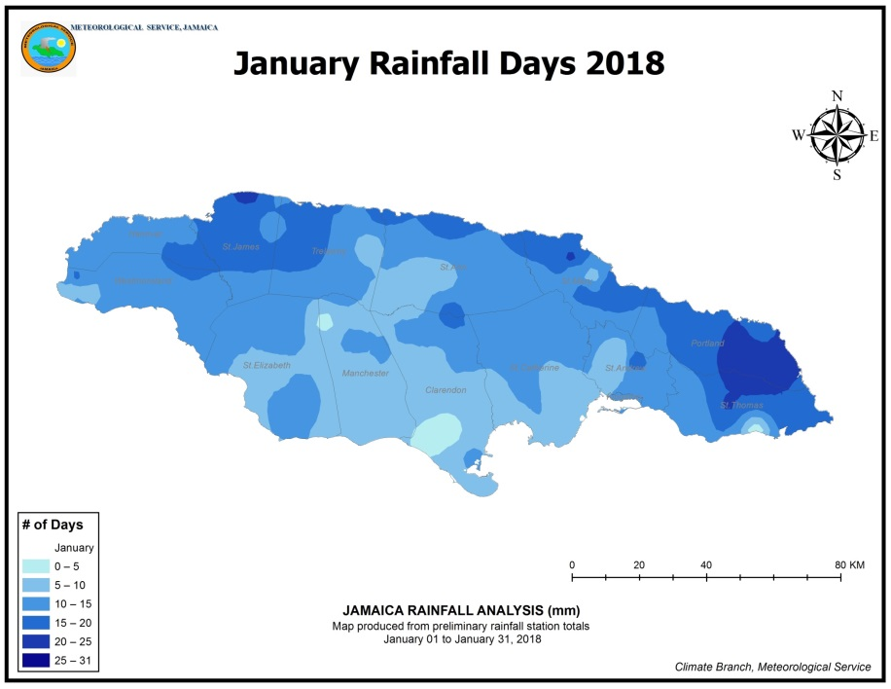
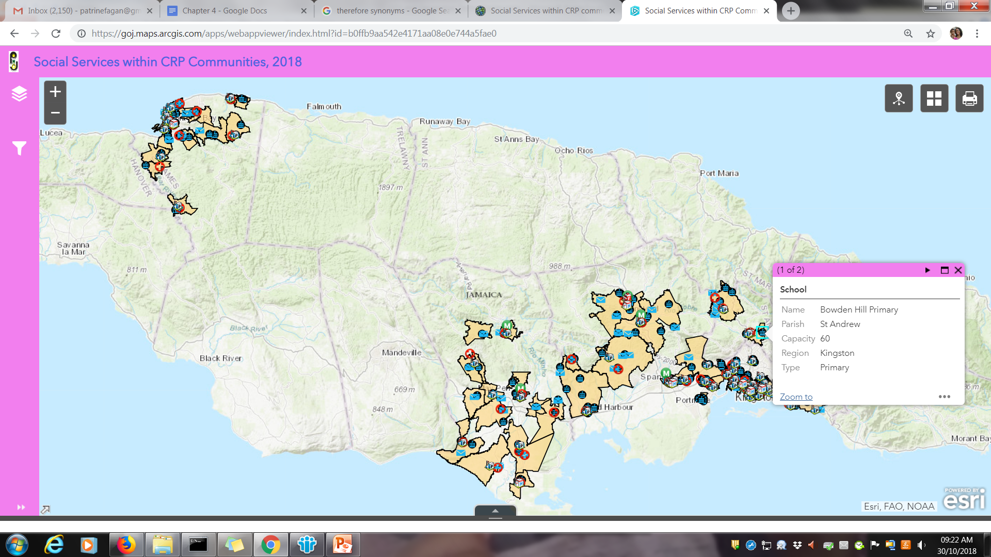
Map and Applications
Met Office - Rainfall Analysis
Weather stations connected to system for automated upload
Community Renewal Programme (CRP) Mapping of Social Services
Notes:
Example of one of the applications which show social services such as post offices, schools and fire stations within CRP communities. https://goj.maps.arcgis.com/apps/webappviewer/index.html?id=b0ffb9aa542e4171aa08e0e744a5fae0

Slide 8
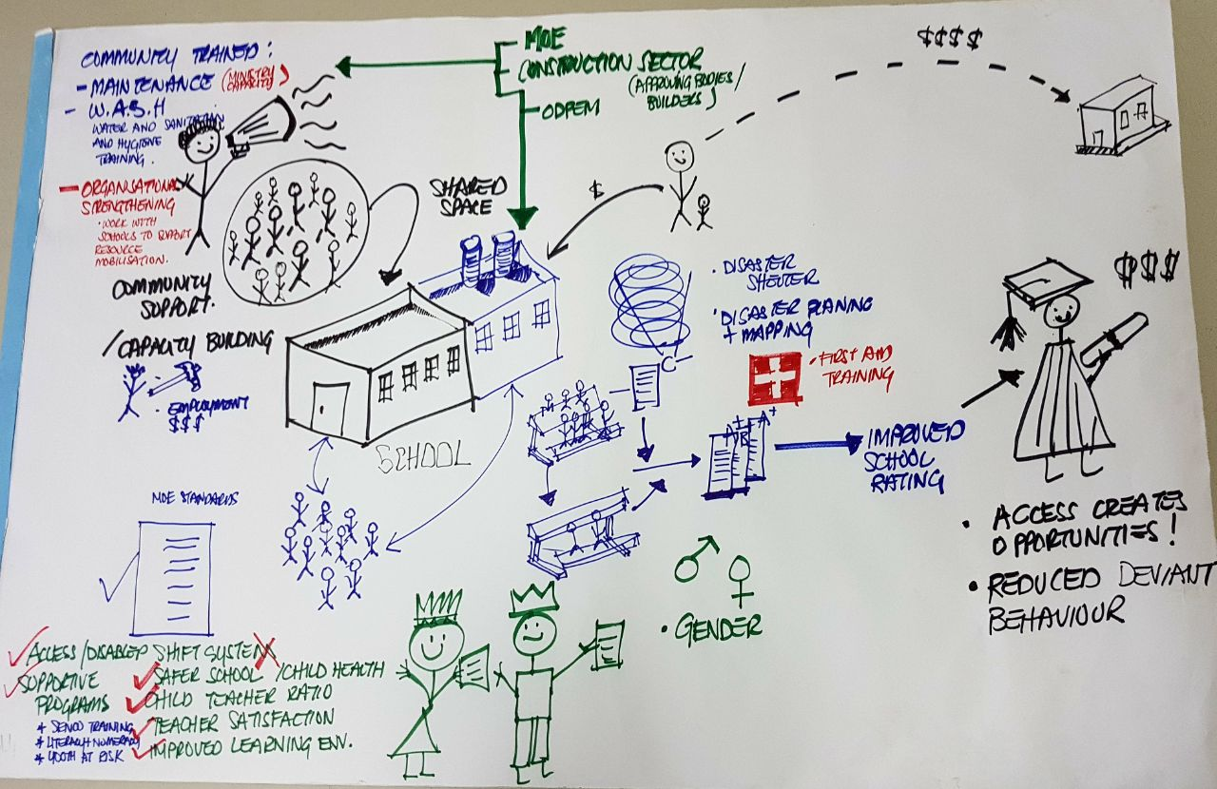
CASE STUDY: Integrated Community Development Project/ Barrett Town Integrated Infrastructure Project
Safety and Security
Increased accessibility to community through road improvement
Health safety with regards to provision of skips and signs for improved garbage disposal
Physical transformation – Housing & Utilities
Major road work inclusive of water pipeline installation and metering.
Livelihoods
Community members were involved in construction, clean up and maintenance activities thereby providing them with temporary jobs and new or improved skillset.
Persons were trained in various skillset by HEART Trust/NTA etc.
Governance at the community level
Capacity building of Community-Based Organizations (CBOs)

Slide 9
Methodology
JSIF’s Operations Manual – Project Cycle
Identification of communities – GOJ, Donor (World Bank), then Project requirements
Community Engagement
sensitization meeting/forum
stakeholder group involvement
Field visit assessments
Feasibility study
Needs spatially mapped using GIS technologies

Slide 10
Methodology
Data collection and recording
Pictures, drive and walkthroughs
Google Earth used for determining location
Creation of features (points, polygons and linear features)
ArcMap a geospatial software tool for spatial analysis and preparation of maps for decision-making and reporting.
Tracking and Project Monitoring
Reports from meetings and site visits logged within the JSIF’s project cycle system (Fund Manager)

Slide 11
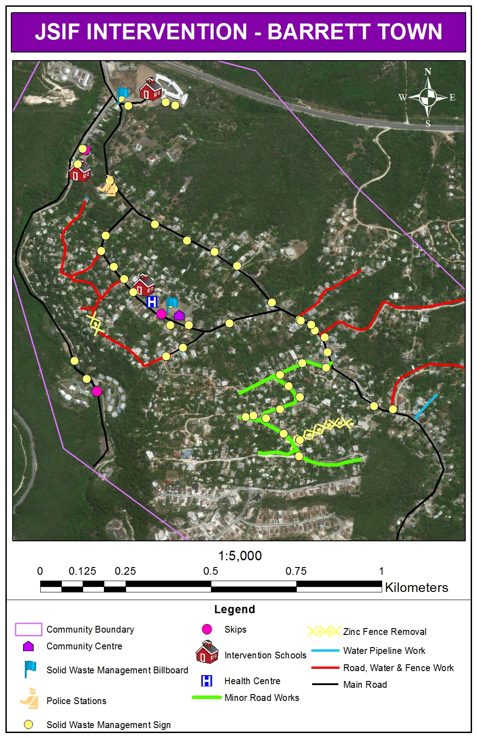

Slide 12
Results/Impacts
The Barrett Town IIP was successfully implemented with skips, installation of new fencing to substitute the original zinc fence and major road works.
Increased accessibility throughout the community for safety and security.
Provide clarity by illustrating the exact locations and extent of JSIF’s interventions in communities across the island.
Reduced time in the decision-making process.
Determine where the community is impacted and ensure that the location and persons with greatest needs are identified to be addressed.
GIS data available for planning, sharing with CRP/PIOJ for improved coordination of development interventions in the community.

Slide 13
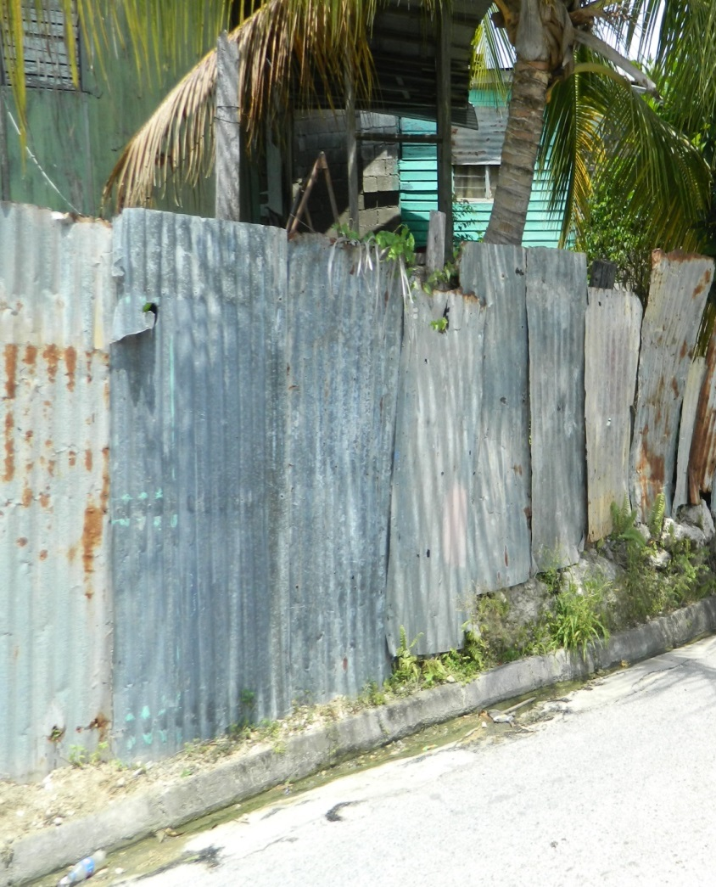
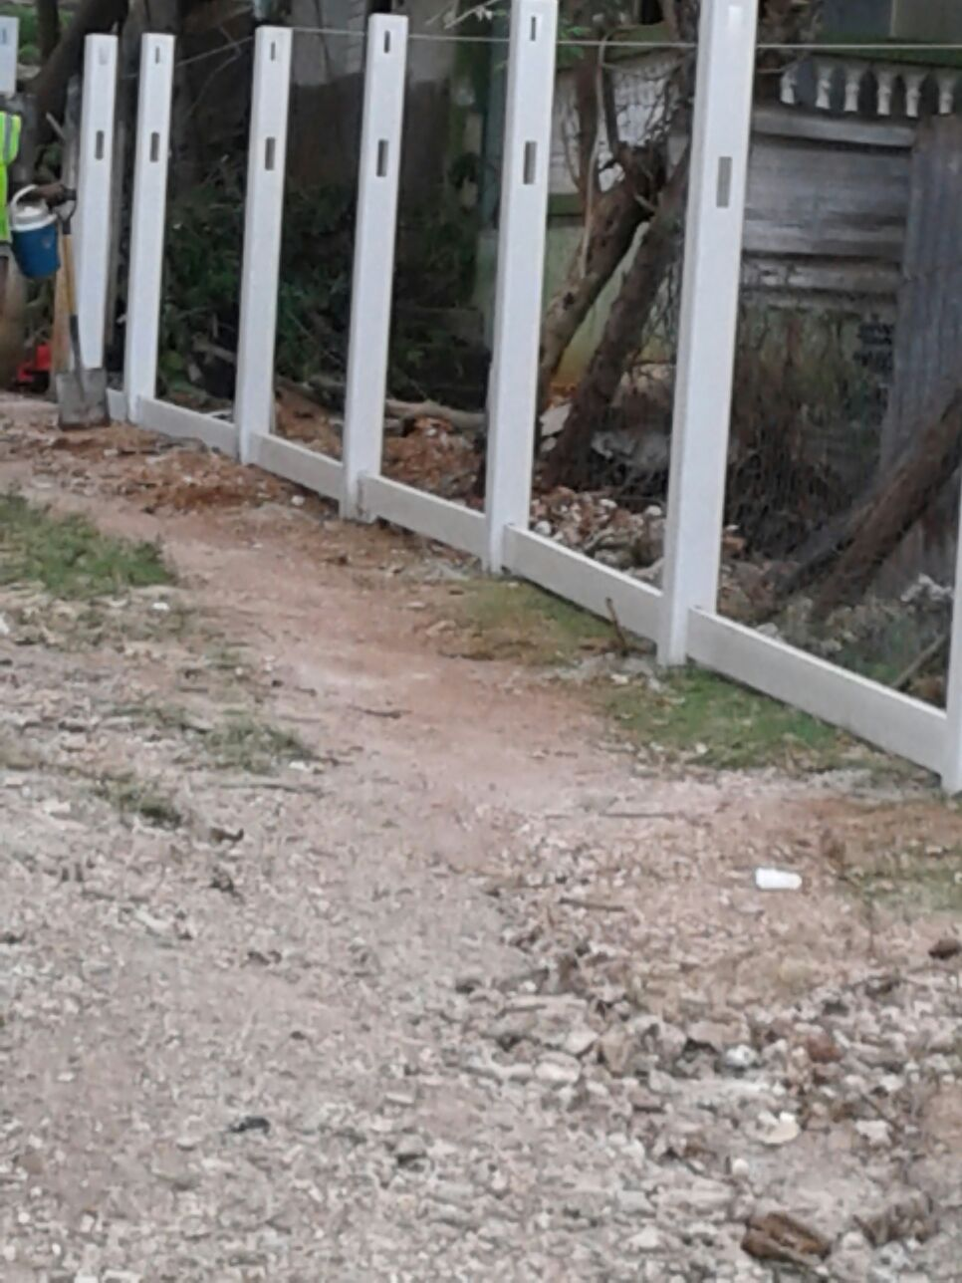
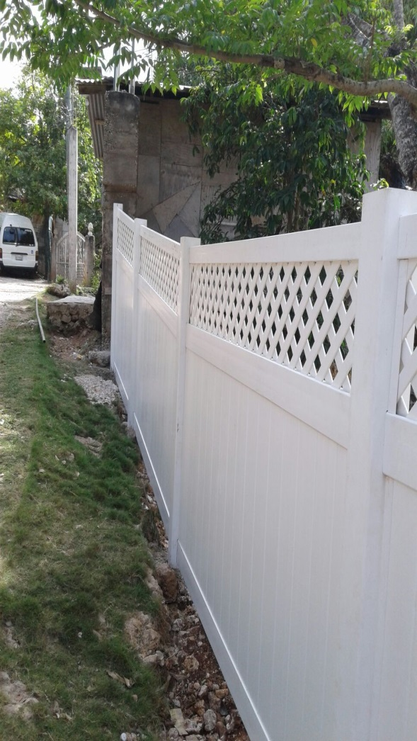
Zinc Fence Removal and Substitution
Before In Progress Completed

Slide 14
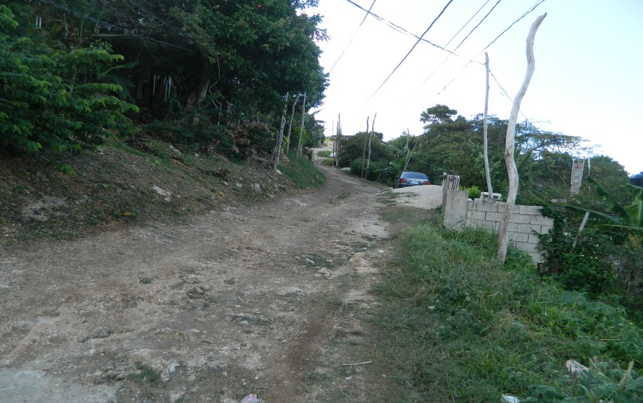
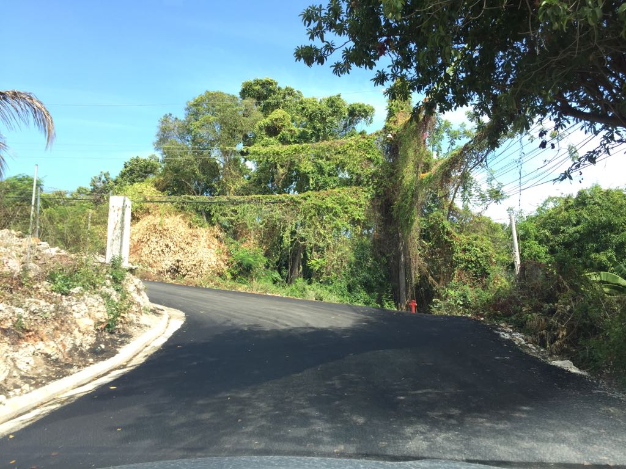
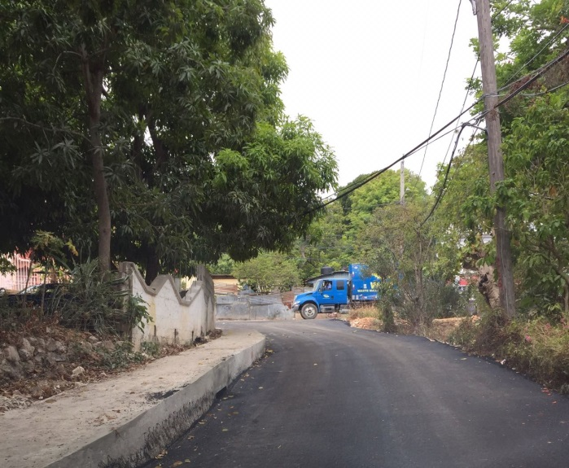
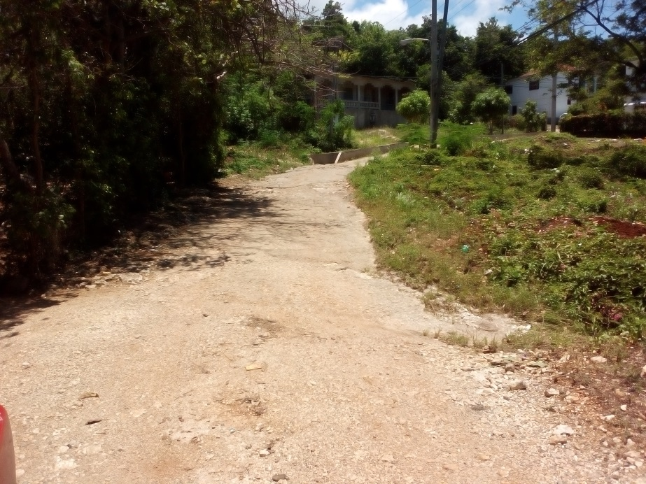
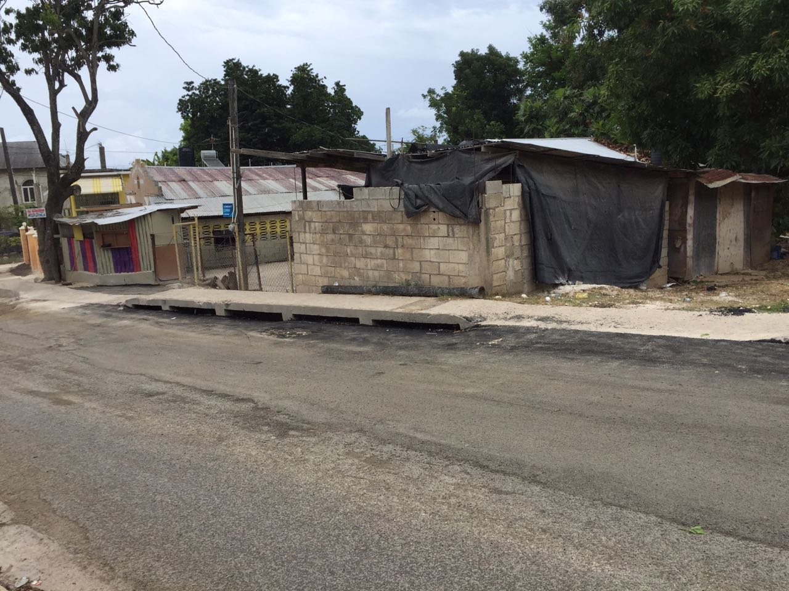
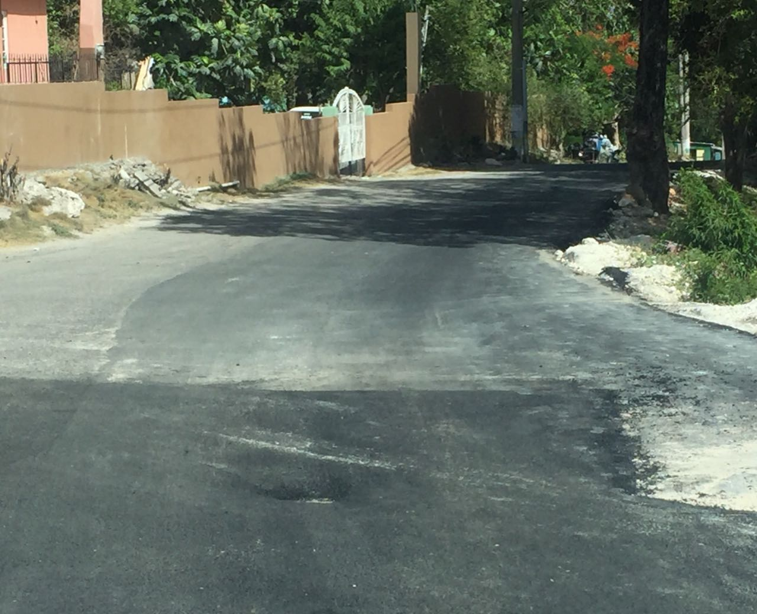
Road Work (sidewalks& drainage)
Before Completed

Slide 15
Planning Institute of Jamaica – Patrine Cole
Jamaica Social Investment Fund – Tami Palmer, Stephan Sinclair
Best Practices Symposium 2018

