Slide 1
Social Enterprises and their Social Rate of Return on Investment within a developing Economy: The Case of Jamaica
Presented by - Kadamawe Knife
Office of Social Entrepreneurship
The University of the West Indies, Mona, Jamaica, November 2006
Best Practices for Community Renewal Symposium JPS/PIOJ

Slide 2
Context - Jamaica
New Generations – Millennial and Indigo Children
No meaningful growth in 5 decades – uncertainty surrounding stability of local currency – SDGs/MDGs
High rates of distrust and perception of crime - Gini Coefficient Increasing above 4
Asset Gini Coefficient 7.26 – high levels of inequity
High happiness index ranking
High social index ranking 43/142
Series of Research being done on Social Economy by OSE - UNDP. USAID/JCF , DIGICEL Fnd, USAID/COMET I&II, USAID/JN Foundation I&II,
Revised MSME and Entrepreneurship Policy

Slide 3
Social Progress Index Porter et al 2014
The Social Progress Index - creates a holistic and robust measurement framework for national social and environmental performance that can be used by leaders in government, business and civil society at the country level as a tool to benchmark success, improve policy, and catalyze action
Three dimensions of the Social Progress Index Framework:
Basic Human Needs,
Foundations of Wellbeing, and
Opportunity.
Jamaica is ranked 43 out of a 132 although Per Capita is not amongst the highest.

Slide 4
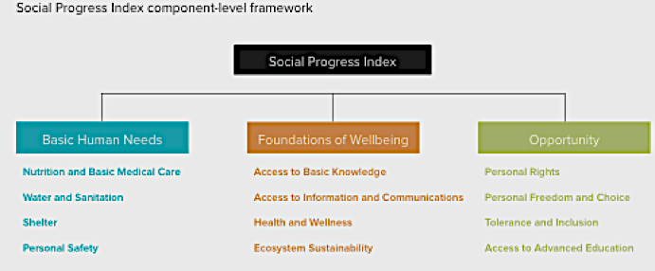
Social Progress Framework (Porter et al 2014)

Slide 5
SE landscape
Data & Methodology
Mixed method approach
Surveyed 100 social enterprises
  In operation for 2 or more years.
  Response rate of 70%
Financials were obtained from only 38 enterprises.

Slide 6
SE Landscape:
Data & Methodology
Limitations
Non-existence of a single registry for social organisation/ social enterprises.
Lack of proper accounting and record keeping

Slide 7
Composition of the Social Enterprise Sector
Organisational structure | Emerging |  | Transitioning |  | Hybridisation
 | Ideation | Start-up | Not-for-profit | MSME | Private sector | Government
Groups | CBOs, Youth groups, Individuals. | CBOs, Youth groups, Advocacy groups. | NGOs, CBOs, FBOs, CSOs, Advocacy groups. | Cooperatives, microenterprises, Agriculture groups, Cottage industries. | Foundations, Charities, Service Clubs. | Agencies and Departments; Quasi-government agencies.
Notes:
Three organisational structures emerged from the research; emerging (ideation and start ups); transitioning (not for profit and MSMEs) and Hybrid (Private Sector and State Agencies). The categorisation includes CBOs and NGOs – that are in an embryonic or transitional stage; MSMEs, with an unclear or undeclared social benefit; and hybrids with connections to the Private Sector, through foundations and charities, and Government Annex I – Table 1; presents the outline typology as Social Enterprise Spectrum

Slide 8
Composition of the Social Enterprise Sector
Micro: 1-10 employees
Small: 11-50 employees
Medium 51-150 employees
Large: greater than 150 employees
Notes:
Size is defined according to the Development Bank of Jamaica definition as: micro business = 1-10 persons, small business = up to 50 persons, medium business = up to 150 persons and large business = more than 150 persons.

Slide 9
Composition of the Social Enterprise Sector

Slide 10
Year of Operation

Slide 11
Funding Sources

Slide 12
Contribution to Employment
 | Male |  |  |  | Female |  |  |  | Total
 | 29 & younger | 30-59 | 60 &Older | Total | 29 & younger | 30-59 | 60 &Older | Total
Full Time | 76 | 59 | 19 | 154 | 100 | 143 | 18 | 261 | 415
% | 49.4 | 38.3 | 12.3 | 28.5 | 24.1 | 34.5 | 4.3 | 37.7 | 33.7
Part Time | 55 | 84 | 8 | 147 | 47 | 53 | 105 | 205 | 352
% | 37.4 | 57.1 | 5.4 | 27.2 | 22.9 | 25.9 | 51.2 | 29.6 | 28.5
Volunteer | 141 | 92 | 7 | 240 | 132 | 91 | 3 | 226 | 466
% | 58.8 | 38.3 | 2.9 | 44.4 | 58.4 | 40.3 | 1.3 | 32.7 | 37.8
Total | 272 | 235 | 34 | 541 | 279 | 287 | 126 | 692 | 1233
% | 50.3 | 43.4 | 6.3 | 43.9 | 40.3 | 41.5 | 18.2 | 56.1
Sector remains heavy dependent on volunteerism (37.8%).
Contributed 767 jobs that paid a salary
  415 full-time posts.
Sector employed 278 youth (between the ages of 14 and 29).
Sector employed 692 females
  261 full-time
  205 part-time

Slide 14
Main Claim
Social Enterprises through their triple bottom, generate significant, economic, social and environmental value. It is through this that the social economy and the social index outperforms the traditional economic-driven indices
QUADRUPLE Bottom Line for countries like Jamaica – emphasis on the generating and sustaining Cultural Value – note Jamaica Global Cultural Footprint – and the value or the creative industries –
Entertainers as professionals (individual or group) give back the most and has established the most Foudations.

Slide 15
Review of literature – Social entrepreneurship
Assigning monetary values to economic, social, cultural and environmental returns provides an opportunity to demonstrate wider value creation
Alternative business philosophy and process
Innovative ways of obtaining economic growth, social development and environmental sustainability for all people on the planet
Process of addressing market and government failures

Slide 16
Social Rate of Return on Investment
Measuring social benefits of nonprofit activity is not easy - benefits are difficult to define, no common understanding of what those benefits are or ought to be exists – PROXIs
SROI is a process – that feeds into an assessment map – it places a monetary value on the outcomes/benefits, so that they can be added up and compared with the costs/investment

Slide 17
Methodology – SROI – benefits
Assesses the efficiency of an intervention
Lifelong performance indicator of social enterprises and social ventures
Monitor performance; to attract external funding; and to reinforce the missions of social ventures
Use to leverage for funding support to decision-making
SROI analysis can provide legitimacy to NPOs or their funders,
Assist in allocating resources efficiently and effectively

Slide 18
Methodology – SROI
Comparing interventions using SROI is difficult as institutional contexts of the target groups whose social needs are served varies (Lingane & Ol- sen, 2004; Scholten, 2005).
Three technical issues:
the use of discount values - inflationary rates
the incorporation of overhead costs – underestimating or omitting some operations cost
determinations of the counterfactual - dead weight and attribution concerns

Slide 19
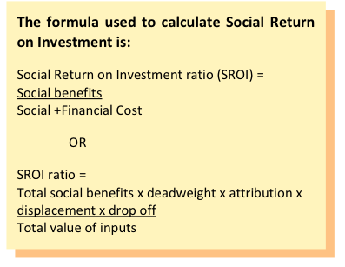
Methodology – SROI - Strengths

Slide 20
Methodology – Using monetization - Indicators
Cost Price –based methods | Value-based methods
Incurred Losses Method | Price Sensitivity Meter
Cost Reduction Method
Averting Behaviour Method
Hedonic Price Method
Cost Prevention Method
Travelling Costs Method
Restoration Cost Method
Production Factor Method
Added Value Method

Slide 21
Methodology – Two Cases
Two Forms of Social Enterprises -
Enterprise’s operations linked into its mission
SEs operation provides employment
Examine the ROI of SEs from both classifications.
Forward Step Foundation – provides training and establishing enterprises where beneficiaries are actively engage in providing goods and services
The New Horizon Christian Ministries - provide training and certification, enabling its participants to earn an income, reduces crime as well as protects the environment.

Slide 22
What is forward Step Foundation – Gregory Park – theory of change
The Forward Step Foundation (FSF) was setup in 2006 to cater to the needs of the youths within the community of Gregory Park, in an effort to facilitate community regeneration through constructive application. The FSF fulfills its mission using a phased approach.
First phase focuses on implementing the Liveli-Up-Yuhself Initiative, A Come – Unity Sustainability Programme which provides training for 25 at risk youths within the Gregory Park and surrounding area. These participants are exposed to life skills training in arts and craft, creative arts (studio engineering and music development) and carpentry – out of which three enterprises are established providing employment to participants

Slide 23
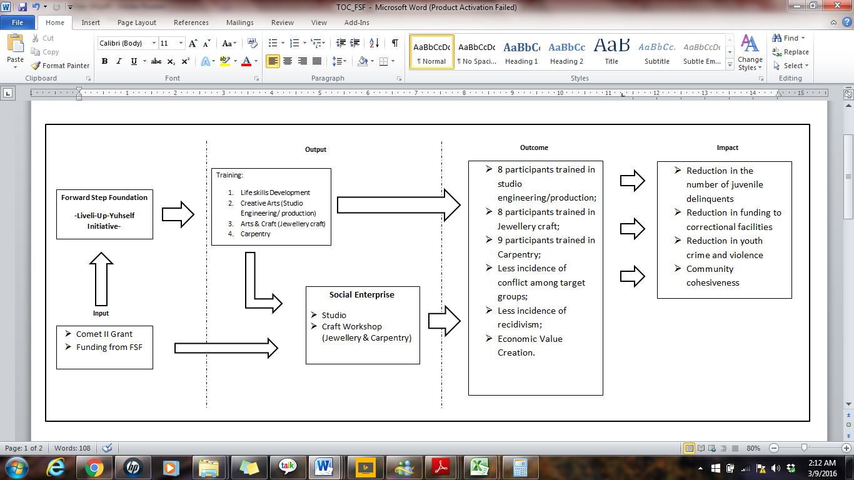

Slide 24
Results/Findings – Forward Step Foundation – Gregory Park – 6 months
Grant funding of J$2,594,000 invested yielded a return of 106% after discounting.
Total Social and Economic benefit = J$2,889,000
Discounted by 5% for attribution = J$
SROI = 2759300/2594000
1.06 This amounts to a return of 106%.
For every dollar of the J$2594,00.00 invested a return of J$1.06 on every dollar invested can be expected.

Slide 25
What is New Horizon Christian Ministry – Golden Acres Community
There are several social issues within this jurisdiction:
inefficient waste disposal and management practices
inadequate resilience with regards to climate change.
increasing unemployment and underemployment among youths.
low self-esteem within youths in the community
All of which may encourage youth engagement in illegal enterprise activities.

Slide 26
New Horizon Ministries (NHCOM) – Theory of Chage
New Horizon Ministries (NHCOM) established a Climate Change and Community Strengthening Initiative within Golden Acres and adjoining communities. The program provides technical training in the area of metal fabrication – to aid in the recycling/waste management initiative - as well as programmes to improve literacy and increase HIV awareness for approximately 56 youth living within the community.
Lizard Town; Golden Acres; Board Villa; Back Bush; Coles Pen; McKoy Lands

Slide 27
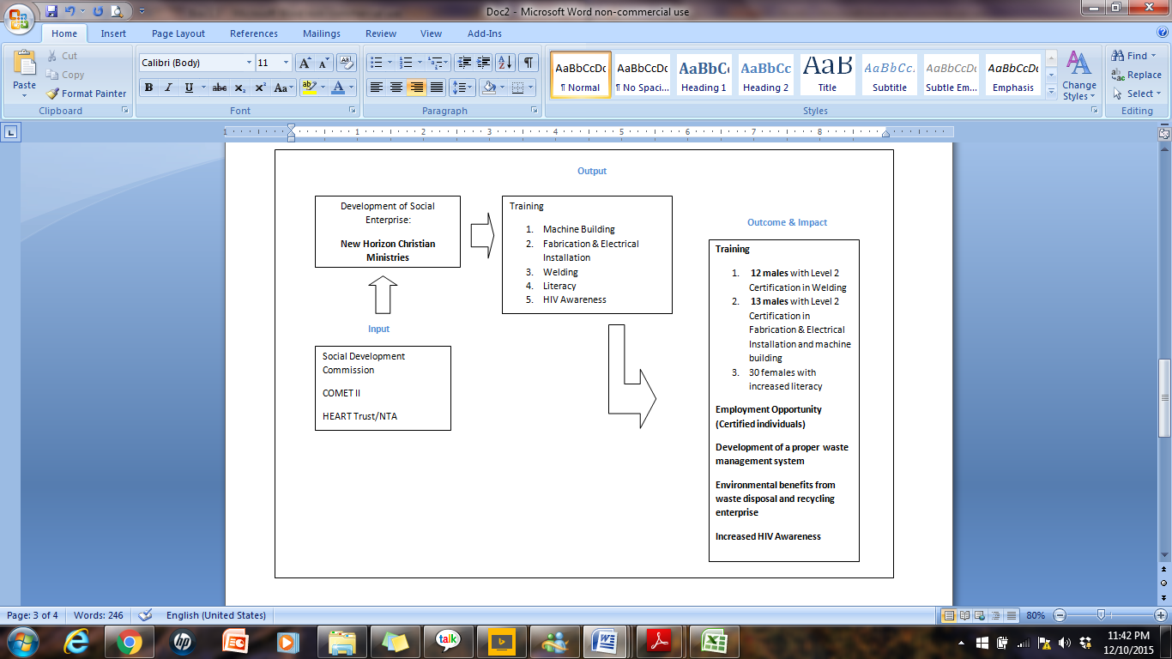

Slide 28
Results/Findings – New Horizon Christian Ministry
Grant funding of J$22413510.00 invested yielded a return of 1045% after discounting.
Total Social and Economic benefit = J$20172759.00
Discounted by 10% for deadweight = J$1929880.00
SROI = 20172759.00/1929880.00
10.45 This amounts to a return of 1045%.
For every dollar of the J$1929880.00 invested a return of J$10.45 on every dollar invested can be expected.

Slide 29
Concluding thoughts
The Social Economy and SEs are keys in the transformation process as they generate significant SROI – evidence by Social Index Ranking
Imperative not to over-estimate or underestimate value creation – use of proxies and monetization are crucial to evidence efficacy of social investments

Slide 30
Love in the House

