Slide 1

Smart Grid, Smart City
Technology Best Practices
November 14, 2018

Slide 2
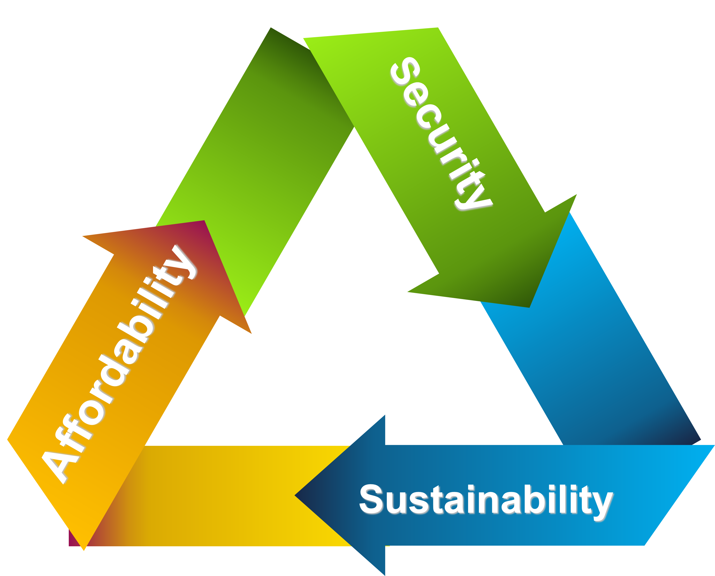
Background
JPS was keen to support the national energy policies
JPS recognized that the grid reliability of yesterday was insufficient today and catastrophic for the needs of tomorrow
The customer demands was changing
The energy landscape was on the verge of transitioning
How will JPS serve its customers better?
Technology and Innovation

Slide 3

What is the WORLD doing?
The world has been investing in smart meters (over 700 Million worldwide)
The world has been investing in smart streetlights (50 Million worldwide)
The world invests annually US$200 Billion in smart grid technologies
The world is merging electric utility assets with communications and software applications (Assets without communication are becoming obsolete).
A standard has been set, the Electric Utility Best Practice for grid and customer improvements is the development of a SMART GRID
Customer Experience
Reliable power
Lower energy bills
No estimated bills
Prepaid energy options
Energy participation (eg. PVs)
Utility Experience
High customer satisfaction
Lower energy theft
Improve Efficiency & productivity
Cost Savings
High accommodation for renewables
Technology and Innovation

Slide 4
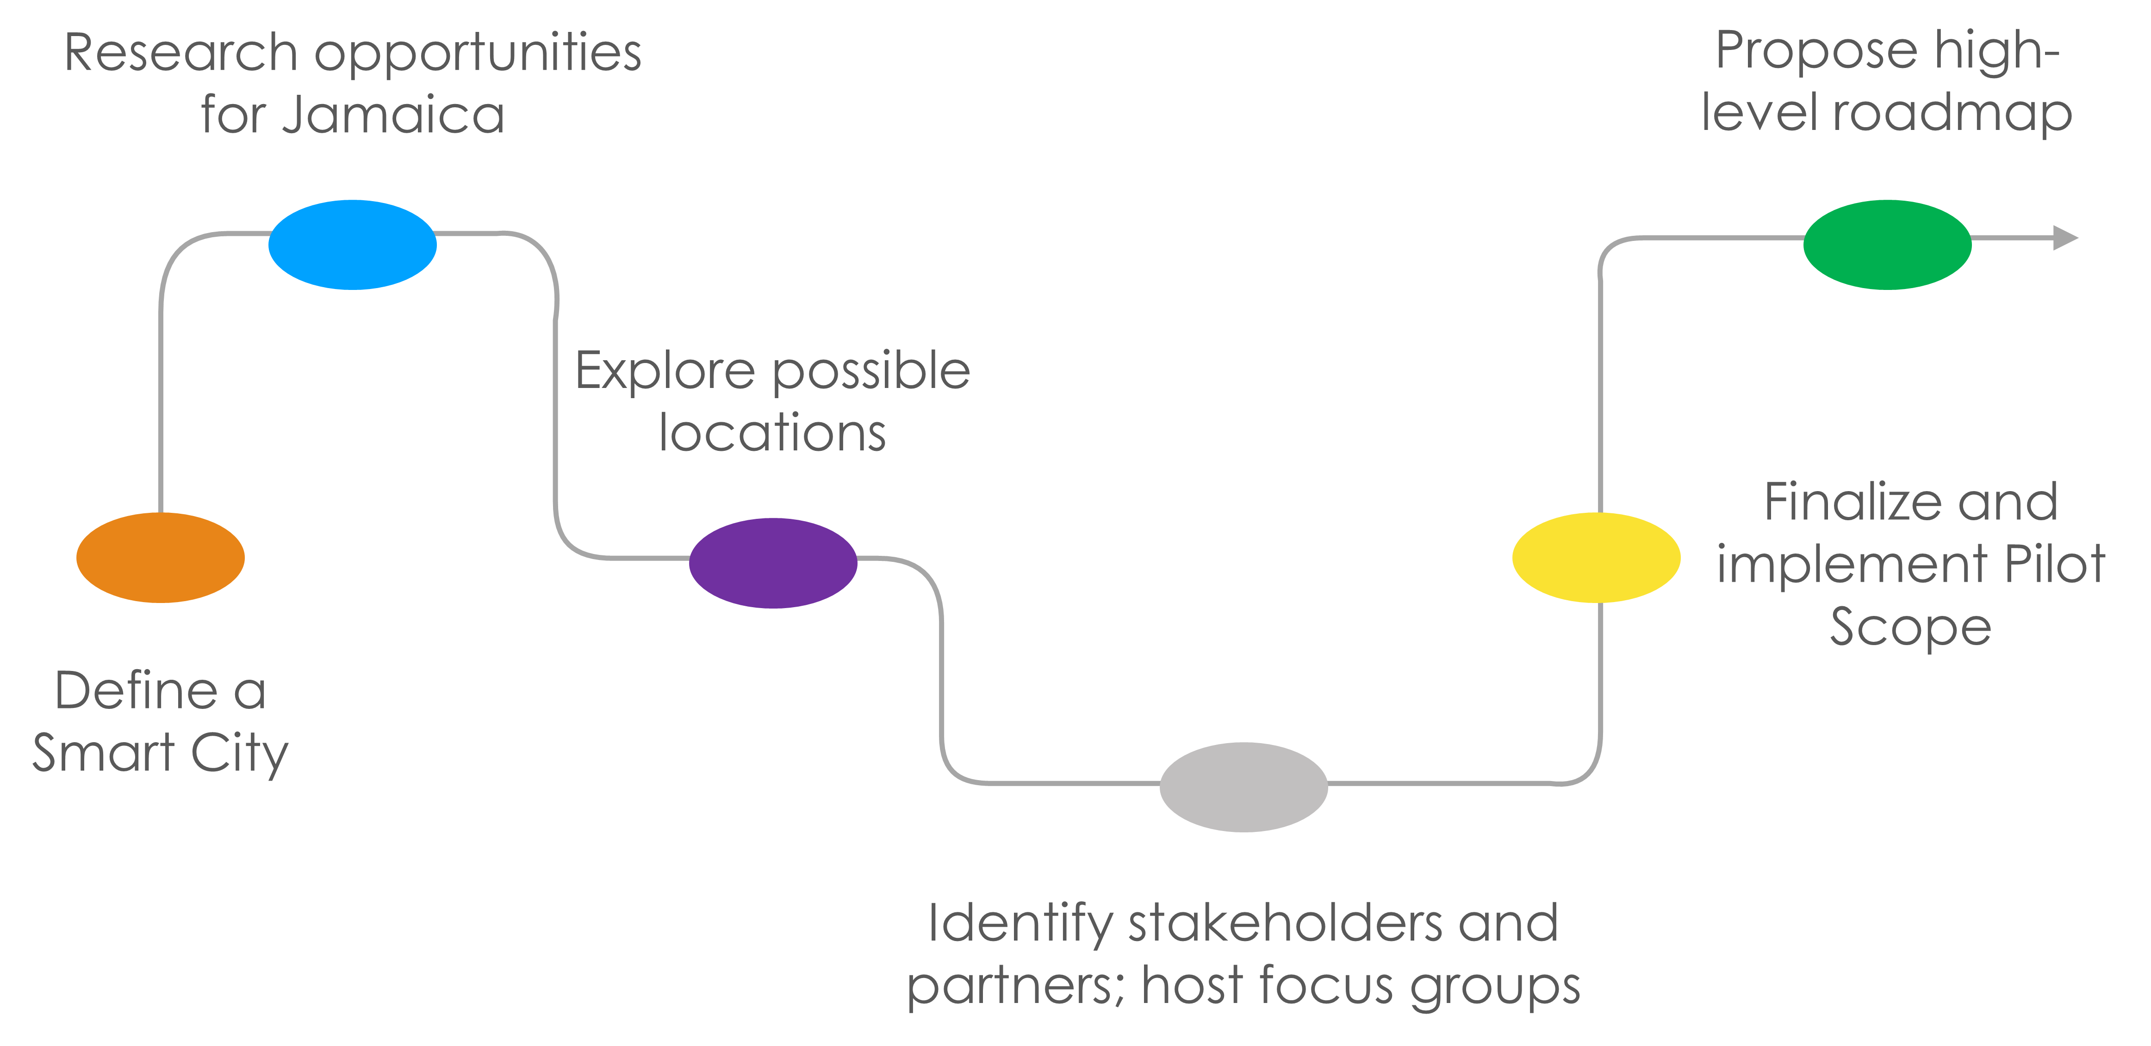
A thinking Company?
How could we use the smart technologies as a corner stone for something greater?
A SMART CITY in Jamaica concept was born
The BEST PRACTICE for countries is the SMART CITY
Technology and Innovation

Slide 5
What Is A Smart City?
Technology and Innovation

Slide 6
Stakeholders
Government
NWA
NWC
JPS
Financial Institutions
Telecoms
Businesses in New Kingston
Residents of New Kingston
Employees of New Kingston
Reactions
Areas of Concern
Business Influencers
          Excited
          Concerned
Residents
Curious
Excited
Employees
Happy/Excited
Sceptical
Security
Parking
Waste Management
Traffic
Technology and Innovation

Slide 7
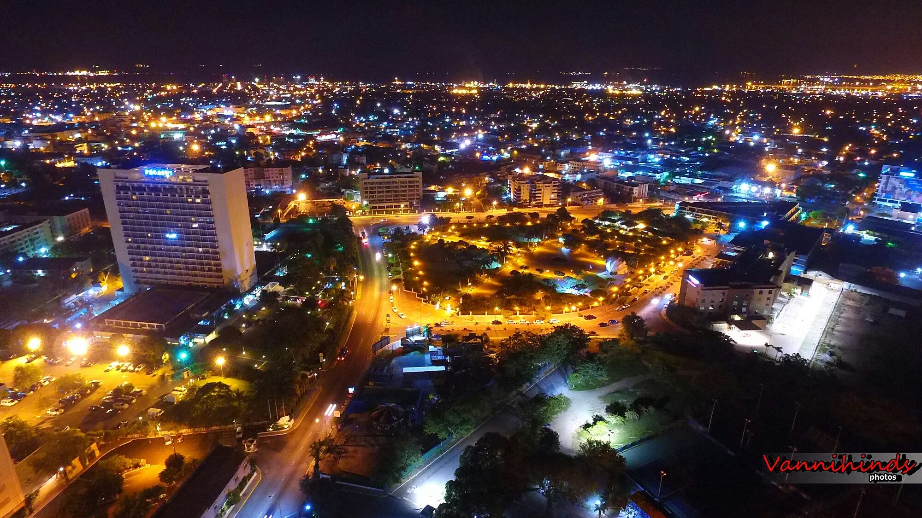


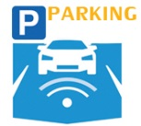




Where Are We?
SMART PARKING
126 parking bays
SMART METERS C&I - 339
Commercial Customers
DIST. AUTOMATION
Electricity Supply Stability
ENERGY WEB PORTAL
Energy Usage Information
SMART STREET LIGHTS
334 Smart LED Lights
FREE PUBLIC WIFI
SMART TRAFFIC CONTROL
Trafalgar Rd & Knutsford Blvd
SMART SURVEILLANCE
Trafalgar Rd & Knutsford Blvd
Technology and Innovation

Slide 8








Jamaica’s Smart City Possibilities
Connectivity
Energy Management
Public Wi-Fi
Water Management
Smart Water Management
Leakage Identification & Prev. Maintenance
Water Quality Management
Smart Energy Management
Renewable Integration
Energy Efficient & Green Buildings and Homes
Smart Lights
Distribution Automation
Education
Digital Records
Tele-Education
Health Care
Waste
Management
Digital Records
Tele-Medicine
Governance & Citizen Services
Smart Waste Management
Recycle
Intelligent Disposal
Waste Reduction
Public Information
Electronic Service Delivery
Citizen Engagement
Citizen’s – City’s Eyes & ears
CCTV Video Crime Monitoring
Urban Mobility
Electric Vehicle
Smart Parking
Intelligent Traffic Management
Technology and Innovation

Slide 9
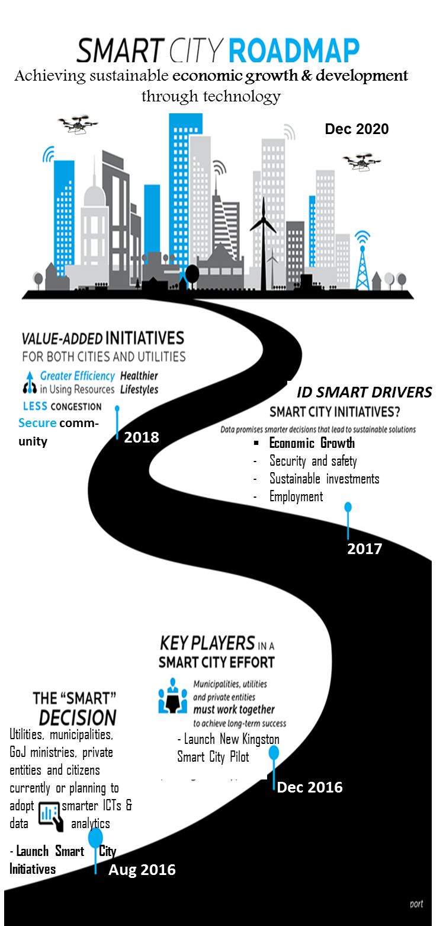

Smart City Roadmap
Achieving sustainable economic growth and development through technology
Value-Added Initiatives
Greater Efficiency in Using Resources
Regulations
Integrate deployed technologies
Define services
Customer Participation
2020
2019
ID Smart Drivers & Partnership Commitments
Data promises smarter decisions that lead to sustainable solutions
Economic Growth
Safety and Security
Sustainable Investments
Employment
Connectivity and Real-Time Data Flow
Operate & Optimize
Assess, review lessons learnt, adjust and optimize the operations of implemented technologies
2018
2017
Launch New Kingston Smart City Pilot
The “Smart” Decision
Utilities, municipalities, GoJ ministries, private entities and citizens are currently or planning to adopt smarter ICTs and data analytics
2016
Technology and Innovation

Slide 10
Example: How you can participate in Smart Grid, Smart City?
Renewables Generation
Lease of Rooftop for Solar Systems
      Unused space that will generate monthly earnings
      Power source from the installed solar panels that will be handy in an emergency
      Waterproofing work conducted when solar panels are installed that prolongs the life of roofs and houses
      Needs to be done as a community
Technology and Innovation

Slide 11
Thank You!
Technology and Innovation

