Slide 1
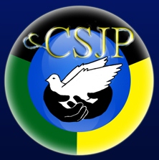
Building Resilience, Changing Lives and Best Practices among our Youths at Risk
Ministry of National Security
Citizen Security and Justice Programme III

Slide 2
Overview
The Citizen Security and Justice Programme (CSJP) III is a multi-faceted crime and violence prevention initiative of the Ministry of National Security which focuses on building community safety and security.
Notes:
Discussion of the key terms:
Youth and violence
Risk
Resilience

Slide 3
Overview
Phase 1 (2001-2009) started in 9 communities (August Town, Grants pen/Barbican, and Fletcher land, Hanna Town, Denham Town, Trench Town, Waterhouse, Towerhill and Drewsland).
Phase 11 (2009-2013) expanded to 50 communities ,after evaluation of Phase 11 and lessons learned it was decided to continue with a phase 111 during which would gradually transfer services to line ministries agencies and departments.
Phase 111 (2013-2019) , 50 pre-selected communities which are located in the Kingston Metropolitan Area, St. James, St. Mary, Westmoreland, St. Ann, Clarendon, and St. Catherine.

Slide 4
Our Funding Partners
IDB, DIFID, DFATD and GoJ

Slide 5
CSJP’s Objective
To Enhance Citizen Security and Justice in Jamaica in 50 target communities.
Notes:
St. James - homicide rate of 114:100,000, higher than the national average
No other parish is so impacted by violence

Slide 6
CSJP’s Components:
1. Culture Change and Community Governance
11. Labour Market Attachment and Employability
111. Community Justice Services

Slide 7
Component 1. Culture Change for Peaceful Co-existence and Community Governance
Involves interventions to provide knowledge, skills and opportunities to change attitudes that tolerate or promote violence , activities include:
Parenting education
Counselling
Gender equality
Physiological services
Violence interruption services
Local governance structures such as Community Action Committees
Construction and equipping of multipurpose centres and other infrastructure

Slide 8
Component 11. Labour Market Attachment and Employability
Deliver comprehensive programs for selected youths at 3 different levels:
Group 1: participants are highest job readiness, receive services such as vocational and on the job training, employment internship, job seeking and placement, support services to tertiary education and business development training.
Group 2: intermediate job readiness, receive services such as on the job training and work orientation.
Group 3: lowest job readiness, receive remedial education particularly literacy and numeracy skills that required to participate in advance training.

Slide 9
Component 111. Community Justice Services
Seeks to increase access to justice services outside of the formal court system. Activities include:
Expansion of Restorative Justice Program
Child Diversion program (steering juvenile in conflict with the law from criminal charges)
Legal Aid Services
Mediation services in schools
Expansion of Justice of the Peace Services
Victim Services including women and children
Notes:
Both the risk factors, resilience factors and interventions occur at the individual, family, community and societal levels.

Slide 10
Who are ‘Youth at Risk’?
At-Risk Youth: Those that have fallen victim to a variety of risk factors that reduce their ability to succeed (Morris, 2000, Kronick, 1997). These youth grow up in circumstances that challenge their ability to stay on a positive life-course into adulthood (Region of Peel Health Review 2014).
Risk Factors: Include but are not limited to low scholastic achievement, school dropouts, behavior problems, poor attendance in school, low socio-economic status.

Slide 11
Who are ‘Youth at Risk’?
Kauai Longitudinal Research 1955-1995:
Monitored the development of all children born on the island at ages 1, 2, 10, 18, 32, and 40 years. 30% of the children studied were considered at-risk because they were born and raised in poverty, had experienced pre- or perinatal complications; lived in families troubled by chronic discord, divorce, or parental psychopathology; and were reared by mothers with less than 8 grades of education. Two thirds of these children developed learning or behavior problems by age 10 or had delinquency records and/or mental health problems by age 18. However, a third of the at-risk group grew into competent, confident and caring adults. The children who succeeded against the odds had protective factors at the individual, family and community level. (all phases focus on these 3 levels)

Slide 12
Profile of Sample of at risk youths referred to CSJP
Figure 1. Percent distribution of a sample of individuals referred to CSJP by risk factor present, %
(n = 1666)

Slide 13
Profile of Sample of at risk youths referred to CSJP by Gender
Figure 2. Percent distribution of a sample of individuals referred to CSJP by risk factor present and sex, %
(n = 1666)

Slide 14
Murder Rate between 1970-2014

Slide 15
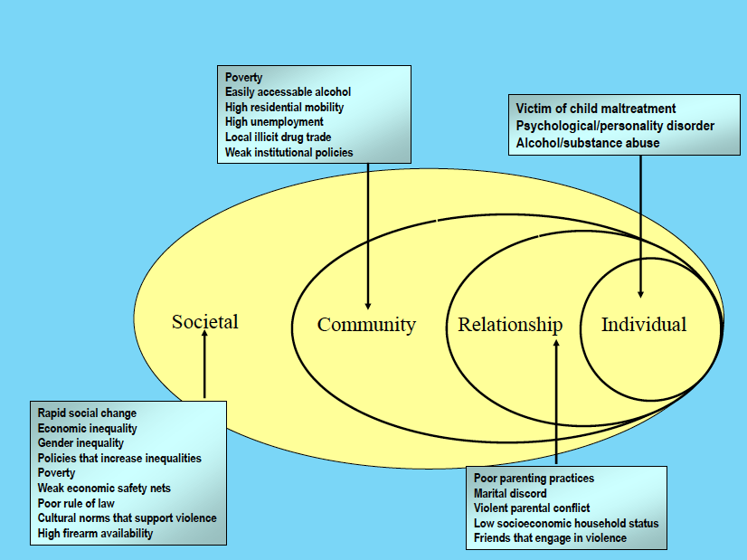
Building Resilience prevents violence
Levels of Interventions

Slide 16
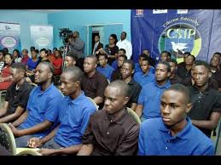
Individual Level
Counselling and psychological support
Empowerment through education and training
Life skills education
Job placement and Employment opportunities

Slide 17
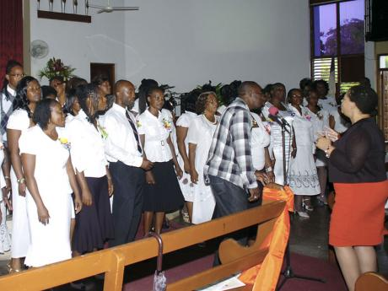
Family Level
Family Level:
Parenting Education
Family Engagement
Family Level:
Parenting Education
Family Engagement
62 Parent Trainers graduate from CSJP Parenting programme training

Slide 18
Community Level
Capacity Building of Community Development
Committees and other CBOs including youth clubs
Community Infrastructure – safe recreational space for youth and the wider community
Support to community level programmes that engage youth – marching bands, community orchestra

Slide 19
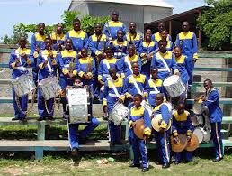
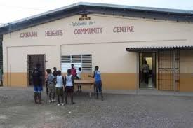
CSJP Builds Resilience

Slide 20
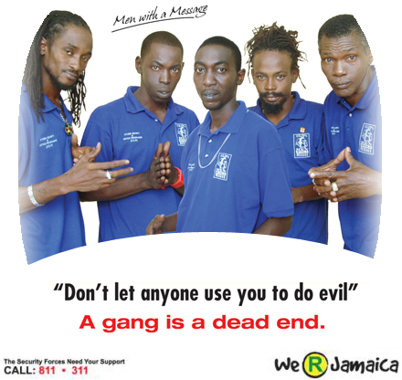
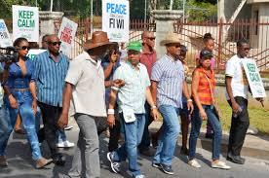
CSJP Builds Resilience
Societal/National level:
Social marketing campaigns for behaviour change
Men with a Message – reformed men share their story of change with youth, schools, communities

Slide 21
CSJP’s Best Practices

Slide 22
CSJP’s Best Practices
Providing Stipend to individuals to assist with transportation and lunch.
Management and monitoring of attendance (through attendance registers).
Monitoring of participants through progress reports completed by host organization –employment internship programme and on the job).

Slide 23
CSJP’s Best Practices
Job Readiness workshops (participants exposed to dress and deportment, interview tips and techniques, resumes and application letters writing, effective communication in workplace, reporting structure etc.) and role plays of areas learnt.
Development workshops (workshops held during training to address issues encountered on the job , EIP or permanent placement).
Providing Life Skills training (616 participants :211M, 405F).

Slide 24
CSJP’s Best Practices
Dedication and Commitment of CSJP staff.
Use of Psychosocial education training (2137 :773M, 1364F).
Monitoring of persons placed in permanent jobs / job retention (phone calls and visits to organizations. (1005 persons placed in permanent jobs including EIP and on –the –job placement).

Slide 25
CSJP’s Best Practices
Adoption of a Case Management Approach where persons are managed from they enter CSJP to their exit through referral or job placement etc.

Slide 26
Finally
Challenges
Limited private sector support to provide on-the-job placement and employment opportunities for youth.
Lottery scam in the Western Region has given youth unrealistic expectations of wealth.
Lack of opportunities for literacy and vocational skills training for youth in the Western Region (few sites provide quality training).
Cultural apathy to counselling and psychological services.

Slide 27
Questions??

