Slide 1
HEART Trust/NTA
IMPACTING THE LIVES OF JAMAICANS
Presenter:- Nicole Manning

Slide 2
HEART TRUST/NTA
The Mission
of the
National Training Agency
“ To facilitate and ensure the development of Human Capital”
Notes:
Improved governance of public/ private training partners and eligible HEART operated institutions through the introduction of a Joint-Venture and Venture Management Status within the Expanded Institutional Framework.
ii. Achieving value for money for the public – the partnerships must have benefits that exceed its costs, and be the least-cost practical way to achieve those benefits.
iv. Maintaining probity and transparency – making sure stakeholders are informed at all times and ensure governance and accountabilities work

Slide 3
Key Mechanisms to Achieve the Mission of the NTA
The National Training Agency
increasingly utilizes a
collaborative machinery through:-
Partnerships
Private & Public Training Entities
Community Level/NGOs
Firms
HEART Operated Institutions
Notes:
Improved governance of public/ private training partners and eligible HEART operated institutions through the introduction of a Joint-Venture and Venture Management Status within the Expanded Institutional Framework.
ii. Achieving value for money for the public – the partnerships must have benefits that exceed its costs, and be the least-cost practical way to achieve those benefits.
iv. Maintaining probity and transparency – making sure stakeholders are informed at all times and ensure governance and accountabilities work

Slide 4
Greater Flexibility through a Competency-Based Framework
Good Practice
Development of a structured programme development framework based on local and international requirements
Programmes developed in consultation with local industry experts, include international requirements
National Vocational Qualification Framework – a Technical Vocational Education & Training Framework with certification levels from 1-5 (equivalence commencing from certificate to a degree)
Notes:
Improved governance of public/ private training partners and eligible HEART operated institutions through the introduction of a Joint-Venture and Venture Management Status within the Expanded Institutional Framework.
ii. Achieving value for money for the public – the partnerships must have benefits that exceed its costs, and be the least-cost practical way to achieve those benefits.
iv. Maintaining probity and transparency – making sure stakeholders are informed at all times and ensure governance and accountabilities work

Slide 5
Certification for “World Class Employees”
Good Practice
Each programme with unit components, clusters yielding a job certifications, National Vocational Qualification of Jamaica (NVQ-J)
Multiple Strategies for Recognition of competencies:-
Assessment after Training
Recognition of Prior Learning)
National Vocational Qualification of Jamaica/Caribbean Vocational Qualification:-
Acceptable locally
Across Caribbean
Internationally
Notes:
Improved governance of public/ private training partners and eligible HEART operated institutions through the introduction of a Joint-Venture and Venture Management Status within the Expanded Institutional Framework.
ii. Achieving value for money for the public – the partnerships must have benefits that exceed its costs, and be the least-cost practical way to achieve those benefits.
iv. Maintaining probity and transparency – making sure stakeholders are informed at all times and ensure governance and accountabilities work

Slide 6
Programme Delivery
Good Practice
Delivery of training:-
Institutions – public and private training providers- in the community/
On-the job
Face to Face and Online
Improved delivery mechanism:-
Changed from instructor-
centred to learner-centred
Engagement of Learners at
multiple sites resulting in the
same certification
Notes:
Improved governance of public/ private training partners and eligible HEART operated institutions through the introduction of a Joint-Venture and Venture Management Status within the Expanded Institutional Framework.
ii. Achieving value for money for the public – the partnerships must have benefits that exceed its costs, and be the least-cost practical way to achieve those benefits.
iv. Maintaining probity and transparency – making sure stakeholders are informed at all times and ensure governance and accountabilities work

Slide 7
Undergirding Requirements
Good Practice
Robust Quality Assurance & Monitoring & Evaluation Framework
Labour Market Analysis (http://lmip.heart-nta.org/) to guide planning mechanism & programme development
School to work transition mechanism:-
School Leavers Training Opportunity Programme (SLTOP)
Apprenticeship
Notes:
Improved governance of public/ private training partners and eligible HEART operated institutions through the introduction of a Joint-Venture and Venture Management Status within the Expanded Institutional Framework.
ii. Achieving value for money for the public – the partnerships must have benefits that exceed its costs, and be the least-cost practical way to achieve those benefits.
iv. Maintaining probity and transparency – making sure stakeholders are informed at all times and ensure governance and accountabilities work

Slide 8
Dual Certification through Partnership = “World Class Employees”

Slide 9
TRANSITIONING FROM NATIONAL VOCATIONAL QUALIFICATION (NVQ-J)
Getting Jobs in the Caribbean with a NVQ-J or a Caribbean Vocational Qualification (CVQ)
Transitioning to other institutions using Jamaica’s National Qualifications Framework

Slide 10
IMPACTING LIVES
“The Magnificent Six”
Notes:
Improved governance of public/ private training partners and eligible HEART operated institutions through the introduction of a Joint-Venture and Venture Management Status within the Expanded Institutional Framework.
ii. Achieving value for money for the public – the partnerships must have benefits that exceed its costs, and be the least-cost practical way to achieve those benefits.
iv. Maintaining probity and transparency – making sure stakeholders are informed at all times and ensure governance and accountabilities work

Slide 11
Dual Certification
Good Practice
National Vocational Qualification of Jamaica (NVQ-J) – Executive Chef - gained at the Runaway Bay HEART Academy now “HEART College of Hospitality Services”
Prochef Level certification from the Culinary Institute of America
“Transition seamless through the partnership with the Culinary Institute of America”
Notes:
Improved governance of public/ private training partners and eligible HEART operated institutions through the introduction of a Joint-Venture and Venture Management Status within the Expanded Institutional Framework.
ii. Achieving value for money for the public – the partnerships must have benefits that exceed its costs, and be the least-cost practical way to achieve those benefits.
iv. Maintaining probity and transparency – making sure stakeholders are informed at all times and ensure governance and accountabilities work

Slide 12
DUBAI
CANADA
JAMAICA
USA

Slide 13
These Chefs provide testimonials similar to many other graduates:-
“Having gone through this programme, I have gained so much knowledge both practically and theoretically. This programme has greatly assisted me in my daily duties managing kitchen operations and also in my delivery in the classroom. I have experienced both personal and professional growth and the international exposure has been quite rewarding”. (Fay Dawkins, Cardiff Hotel & Spa)
“This is my only certification and I am so proud to have gone through the programme. I am a Certified Chef de Cuisine and a Certified Executive Chef and I am so proud of these international recognitions. I am now quite marketable and I can use my certification to go anywhere in the world. I have become a role model for many and even my children are following my footsteps. I am forever grateful for having had this experience”. (Lincoln Peterkin, Pegasus Hotel)

Slide 14
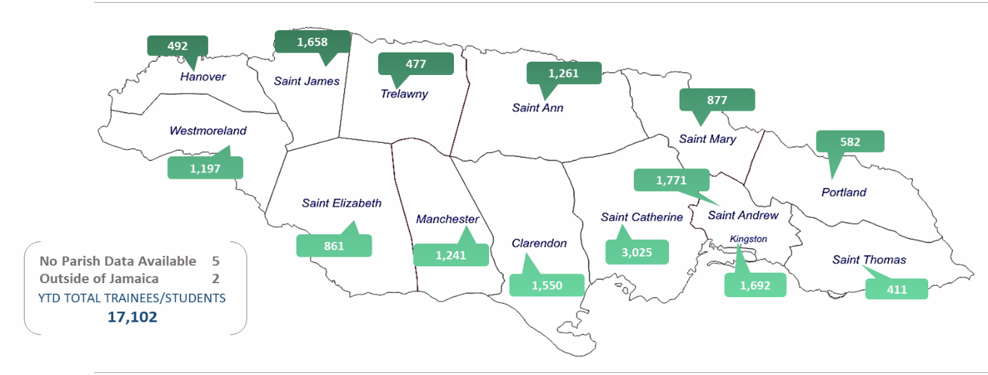
Distribution of Awards issued to Trainees/Students By Parish of Residence

Slide 15
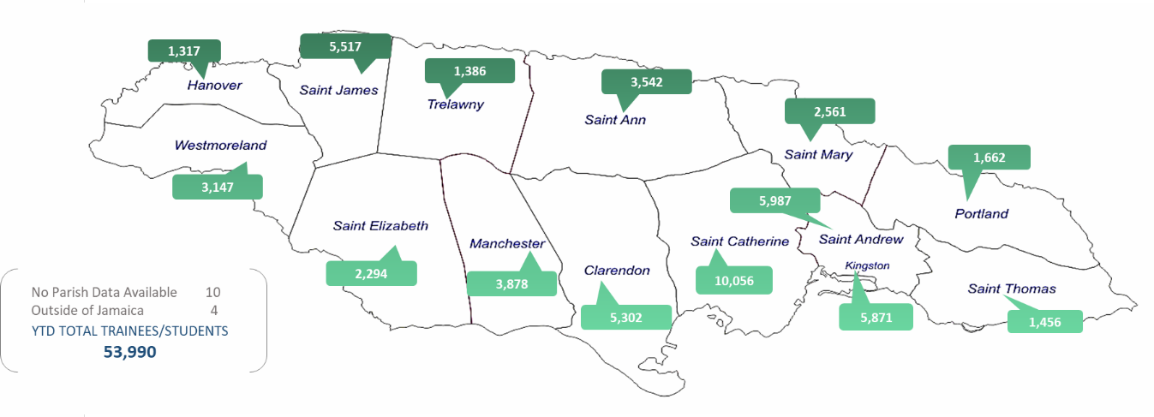
Distribution of the number of Trainees/Students Enrolled per Parish of Residence

Slide 16
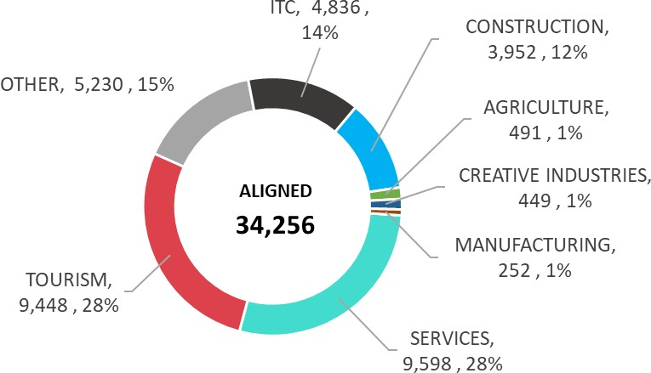
97.5%
Alignment
Sectoral Distribution of Enrolment Aligned to Labour Market Needs

Slide 17
“WHILE WE ARE NOT THERE YET, THE WORK DONE SO FAR IS EVIDENCE THAT WE ARE ON OUR WAY AS WE CONTINUE TO IMPACT THE LIVES OF JAMAICANS………..”

Slide 18
A more direct approach to Recruitment
Greater focus on Unattached Youth
Greater Collaboration with Employers to engage in training earlier to facilitate
- Smoother School to work transition
- Creation of more equipped & better
quality employees

Slide 19
Partnerships with more private/public training providers and firms to facilitate:-
- Increased access to training and
certification opportunities across
the country, especially in rural
areas
- Increased Dual Certification

