Slide 1
Best Practice Symposium for Community Development: safety & security
PRESENTATION BY
Ministry of National Security
November 14, 2018

Slide 2
….. In the Past
Enforcement
Changing Laws
Police Operations Justice
Crime Management Strategies
Prevention Social Development, Diversion, Community Policing Community Capacity
Notes:
Initially very reactive with focus on law enforcement methods with some emphasis on community based policing

Slide 3
Today …….
Enforcement
Changing Laws
Police Operations Justice
Prevention Social Development, Diversion, Community Policing Community Capacity
Crime Management Strategies
Notes:
Today – proactive approach
Evidence based / data driven
Focusing on risk factors affecting vulnerable individuals and community and replacing that with protective factors
Collobartive partnerships -

Slide 4
MULTI-SECTORAL APPROACH TO COMMUNITY SAFETY
Notes:
Multi sectoral approach

Slide 5
Policy Framework
Policy level
Vision 2030
Integrated Social Intervention Strategy
National Crime Prevention & Community Safety
Medium Term Socio-Economic Policy Frameworks (MTFs)
National Security Policy
Notes:
Vision 2030 Safety and Security Goal 2
MTF - With regards to citizen security national outcome No:3 Effective Social Protection , No: 5, Security and Safety, and No: 6, Effective Governance

Slide 6
Policy framework
National Crime Prevention and Community Safety Strategy
5 Pillar Strategy
Effective Policing
E Policing
Crime Prevention through Social development
Reducing Reoffending
Situational Prevention
Swift and Sure Justice

Slide 7
Enforcement/public safety framework
JCF to :
Operate and Maintain Modern Technology Applications to address Public Safety and Citizen Security Issues.
Aim was to achieve:
Steady and Gradual Build up of Applications
Smart Policing
Notes:
Impact Crime NOW leading to Results growing and showing significantly
between 1-3 years of implementation commencement 2018-2020
Aim to Build Police Force in which every Jamaican will have Pride, Trust and Respect

Slide 8
Enforcement/public safety framework
Data Integration & Cyber Security
Case Management
Asset Management
Border Control
Surveillance (CCTV/Jamaica Eye)
Drones
JCF Transportation
IT Governance
Secure Correctional Services
ICT Networks

Slide 9
Context: Social Development
While the police, courts and correction attempt to control crime, their scope for further crime reduction is limited
Opportunity reduction can displace crime in short term but …
Various studies reveal that Crime Prevention Through Social Development (CPTSD) programmes have a positive impact on promoting of pro-social behaviours in at-risk populations
Notes:
Opportunity reduction can displace crime in short term but … it may not reduce crime in long term

Slide 10
Context: Social Development (cont’d)
The Ministry of National Security has embarked on a more fundamental and all encompassing programme aligned to the 5 Pillar Strategy for Crime Prevention and Citizen Security
Focused on some chief priorities to improve citizen security at the community level:
Public order and law enforcement,
Strong anti-gang strategies
Anti-corruption strategies
Targeted social intervention initiatives in volatile communities, and
Transformation of our Police Force into a modern Service

Slide 11
Policy Framework: Social Interventions (cont’d)
Community level - Anchor Partnerships
Police
Private Sector
Other M/D/As
CBOs NGOs FBOs
Local Government – SDC
Community – Parents, youth
Notes:
This framework includes key stakeholders necessary for a safe and secure community

Slide 12
Integrated Social Intervention Strategy
Partnership across all sectors with a focus on public order and enhanced access social amenities
First implemented in St. James
Targeted social intervention programmes:
Community animation
I Am Voluntourism
Goals for Peace mns, csjp, pmi
I am Purpose Campaign
CSJP Initiatives
PMI
Notes:
Social amenities – WIFI supported homework, recreational zones, and social capital in vulnerable communities
CSJP Initiatives – parenting, life skills, victim services, restorative justice
PMI – mediation, sports, grief counselling

Slide 13
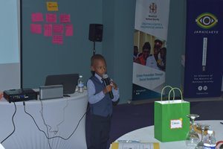
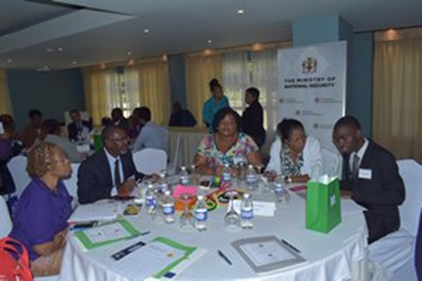
Integrated Social Intervention Strategy (cont’d)
Community Animation Programme - (June 2017 and January 2018) workshops geared at empowering community leaders and other stakeholders with the tools to facilitate an asset based approach to community development - visioning, consensus building, social enterprise - 180 persons trained across 6 communities
Example of social enterprise : Landscaping project – Rose Heights
partnership with HEART 22 persons being trained
Notes:
Animators - Leadership programme – each one change one –change agents
Elements – social enterprise, visioning, consensus building
Landscaping - as part of the animation programme 22 social enterprises – business development training provide equipment – startup capital – Rose Heights -

Slide 14
Integrated Social Intervention Strategy (cont’d)
I AM Voluntourism – camp and education model which integrates, sports, service learning,, career, education, and entrepreneurial activities
The programme offers various life skills training opportunities with the use of music, sports and culture.
Recruits at-risk youth actively and engages them to participate in structured development programmes from targeted communities in St. James.
Notes:
The I am Voluntourism is a camp and education model which integrates, sports, service learning, life skills, career, education, and entrepreneurial activities for at-risk youths -

Slide 15
I AM Voluntourism (cont’d)
Objectives:
To increase local and international voluntourism that directly supports violent prevention activities and positively impacts local economies
To provide sustainable solution for crime reduction by integration of business operational models as a core learning component for athletes'’ ongoing participation
Recruit cohort of 150 at-risk youth in Rose Heights, Salt Spring, Mt. Salem, Lilliput, Barrette Town, Canterbury, Green Pond

Slide 16
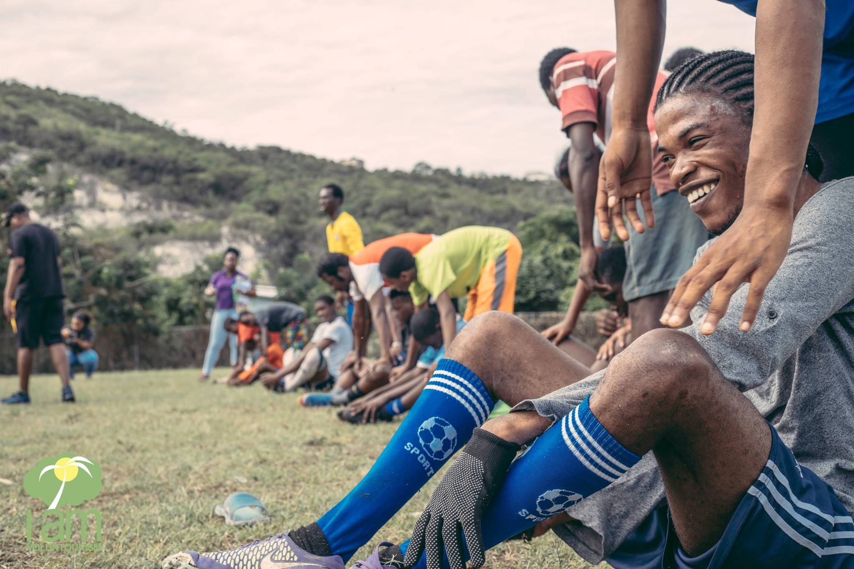
Football Scouting October 2017

Slide 17
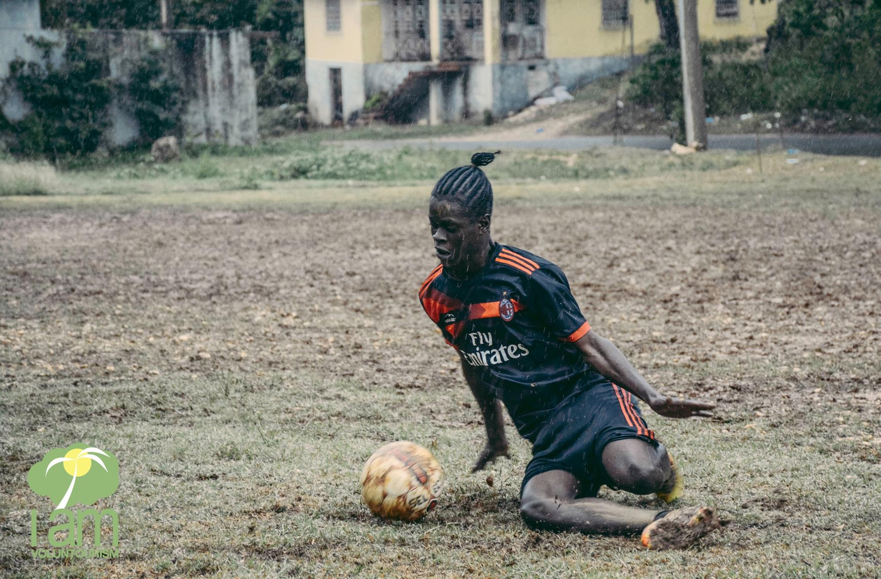
Football clinic March 2018

Slide 18
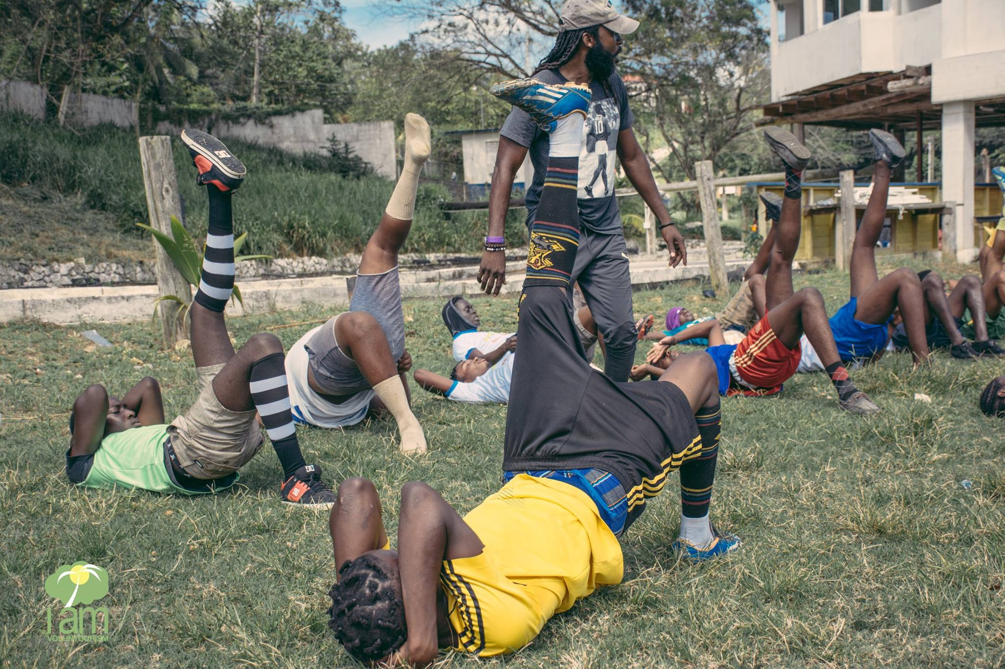
Football Clinic March 2018

Slide 19
Integrated Social Intervention Strategy (cont’d)
Goals for Peace
use of football tournaments to get youths together to assist in eradicating violence that has been plaguing the communities
8 communities engaged including Flanker, Norwood, Lilliput, Barrett Town, Canterbury, North Gully, Downtown and Mount Salem
Notes:
Goals for Peace - in partnership with CSJP, PMI, SDC and the JCF-CSSB,
Mr. Simmonds will elaborate in his presentation

Slide 20
Challenges
It is hard to define and compare cost effectiveness of different crime prevention interventions when outputs, outcomes etc. are depicted in different ways
Lack of Robust monitoring and evaluation tools
Issue of “ownership” and greater collaboration among other key Ministries/Departments/Agencies
Collaboration and exchange of ‘what works’ information is limited or sometimes undocumented

Slide 21
Way Forward
Revision of the NCPCS
Development of a coordinated M&E framework for the social interventions
Development of an Integrated Governance and programmatic framework to build resilience in priority communities
Implementation of the Music Sports and Technology Programme
Comprehensive Youth Offending Strategy
Transition of CSJP III
Notes:
Development of an integrated Governance and programmatic framework – replication of the Si. James model via SDC Inter-agency Network
MST – vulnerable communities relevant activities that positively change antisocial behaviours
Comprehensive Youth Offending Strategy – to complement the Diversion strategy
Transition of CSJP III – emphasis on case management

Slide 22
Thank you!!!!

